Slide 1
Section 3
Technical Assistance
Training for Contractors
JANUARY 29, 2025 – 9:30AM – 10:20PM

Slide 2


Division Contact Information
Kennisha London
Deputy Director
Chrystal Boyce Division Manager
2100 Travis, 9th Floor, Houston, TX 77002
www.houstontx.gov/housing

Slide 3


Our Team Members
Patricia Holcombe
Contract Administrator
Kadina Seals
Contract Administrator

Slide 4

Purpose
The purpose of Section 3 of the Housing and Urban Development Act of 1968 is to provide jobs, training, and contracting opportunities for low-income persons and businesses that substantially employ them through certain HUD grants and funding programs.

Slide 5



Section 3 Benefits
Contracting, employment and training opportunities generated for low and very low income persons and businesses that employ such individuals.
Helps businesses and workers foster relationships on community development projects.
Provides preference and regular alerts to certified business concerns and workers when contracting and employment opportunities arise.

Slide 6
Discussion Topics
Purpose
Benefits
Definitions
Section 3 Threshold
Numerical Goal Requirements
Section 3 Business Concern
Section 3 Worker and Targeted Worker
Section 3 Directories
Certification Processes
EBID, EOA and Bid Tabulation
Post Award Activities
Compliance Forms Packet
- >$100,000.00
- <$100,000.00
LCP Tracker Auditing System
Contractors Performance
Closeout Evaluation
Resource Links

Slide 7
SECTION 3 DEFINITIONS

Slide 8
Section 3 Definitions
Contractor: (1) A recipient to perform work in connection with expenditure of public housing financial assistance or for work in connection with a Section 3 project; or (2) A subrecipient for work in connection with a Section 3 project.
Subcontractor: Any entity that has a contract with a contractor to undertake a portion of the contractor's obligation to perform work in connection with the expenditure of public housing financial assistance or for a Section 3 project.
Section 3 Covered Contract: Any contract or subcontract (including contracts for professional services) awarded for work generated by a Section 3 covered project. Section 3 requirements do not apply to material supply contracts.
Section 3 Covered Project: A Section 3 covered project involves the construction, reconstruction, or rehabilitation of housing, or other public construction.
Labor Hours: The number of paid hours worked by persons on a Section 3 project.
Low-Income Individuals: Workers residing in the Houston metropolitan and non-metropolitan areas who do not exceed the 80% HUD Area Median Income Limit.
YouthBuild Programs: YouthBuild programs receiving assistance under the Workforce Innovation and Opportunity Act (29 U.S.C. 3226).

Slide 9
SECTION 3
THRESHOLD

Slide 10

Section 3 Threshold
Section 3 compliance applies to all contracts in excess of $100,000.00 for housing construction, rehabilitation, or public construction.

Slide 11
SECTION 3
NUMERICAL GOAL REQUIREMENTS

Slide 12
Section 3 Contracting and Labor Goals
Contracting Goals
10% of the construction budget must be directed to Section 3 Business Concerns; and
3% of the non-construction budget must be directed to Section 3 Business Concerns.
Labor Hour Goals
25% of all labor hours performed must be by Section 3 Workers; and
5% of all labor hours performed must be by Section 3 Targeted Workers.

Slide 13
SECTION 3
BUSINESS CONCERN

Slide 14
Section 3 Business Concern
Section 3 Business Concern: is a business that meets at least one of the following criteria, documented within the last six-month period:
Category 1 - 51% of the business is owned and controlled by low-income person(s)
Category 2 - 75% of the business labor hours performed over the prior three-month period was by low-income person(s)
Category 3 – 51% of the business is owned and controlled by current public housing residents or residents who currently live in Section 8 assisted housing

Slide 15
SECTION 3
WORKER & TARGETED WORKER

Slide 16

Section 3 Worker
Section 3 Workers: Any worker who currently fits or when hired within the past five years fit at least one of the following criteria:
(1) A worker’s income for the previous or current calendar year is below HUD income limits;
(2) Employed by a certified Section 3 Business; or
(3) A YouthBuild participant.

Slide 17
Section 3 Targeted Worker
Section 3 Targeted Worker: A Section 3 Targeted Worker means any worker who is:
(1) Employed by a Section 3 Business Concern; or
(2) A worker who currently fits or when hired fit at least one of the following categories, as documented within the past five years:
(i) A resident of public housing or Section 8-assisted housing;
(ii) A resident of other public housing projects or Section 8-assisted housing managed by the PHA that is providing the assistance; or
(iii) A YouthBuild participant.

Slide 18
SECTION 3 DIRECTORIES

Slide 19
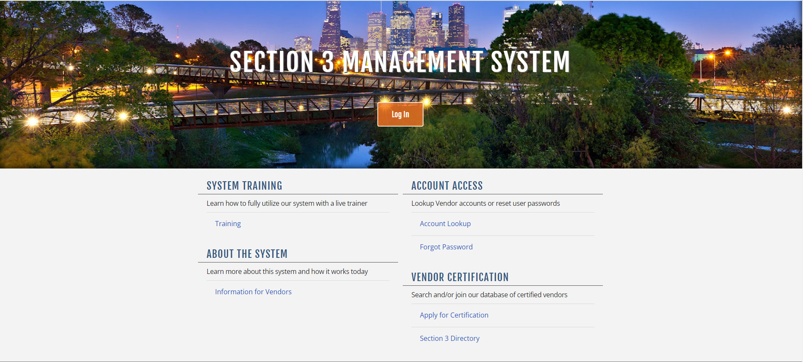
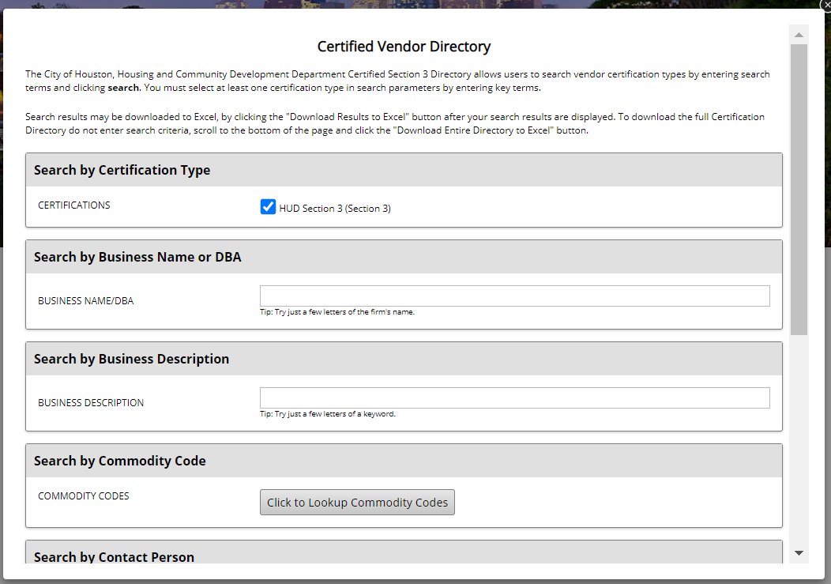
Section 3 Business Concern Directory
To receive credit towards numerical goal requirements on City of Houston projects, businesses must be certified through the City of Houston Housing and Community Development Department (HCDD).
HCDD maintains an online list of eligible Section 3 Businesses and notifies them when contracting opportunities are available.

Slide 20

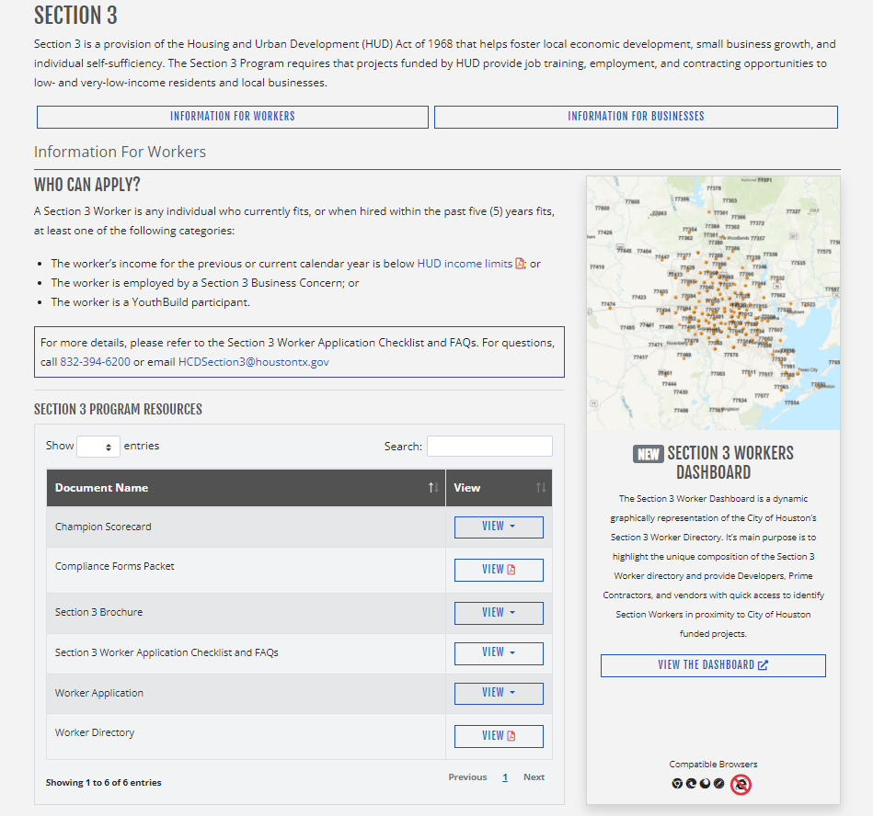

Section 3 Worker Directories
To receive credit towards numerical goal requirements, workers must be certified through the City of Houston Housing and Community Development Department (HCDD).
HCDD maintains an online list of eligible Section 3 Workers by skill/trade and notifies them when employment opportunities are available.

Slide 21
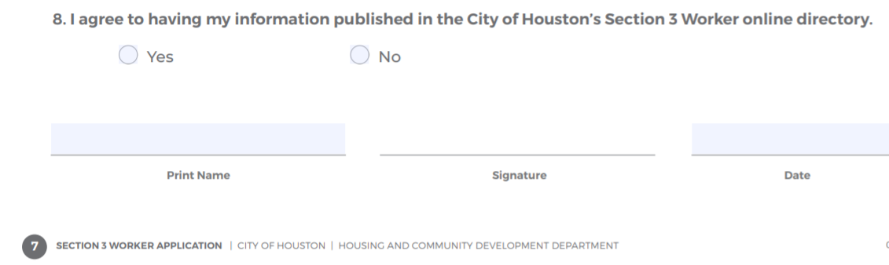
Section 3 Worker Directories (cont’d)
Published Directory:
Workers can opt in to being placed on the public Section 3 Worker Directory on HCDD website.
These workers receive email notifications of employment and training opportunities.
Non-published Directory:
Workers can opt out of the public directory and they do not receive email notifications.
* Directories are available upon request to assist with Compliance Reporting*

Slide 22
SECTION 3 CERTIFICATION
PROCESSES

Slide 23



Application Processes
Section 3 Business applications are only accepted through B2GNow
The application and the Section 3 Business directory: https://hcddsection3.gob2g.com/
Section 3 Workers applications are completed via link here: https://arcg.is/LWXaf

Slide 24

Section 3 Mobile Unit
Assist with onsite certification of workers and subcontractor businesses.
Available for economic opportunity presentations.
Share community and essential resources.

Slide 25
E-BID, BID TABULATIONS AND EMPLOYMENT OPPORTUNITY ANNOUCEMENTS (EOA)

Slide 26
E-BID Requirements
When contracting opportunities arise throughout the duration of the project, an E-BID Announcement (E-BID) must be submitted for dissemination to Section 3 Businesses in HCDD’s online directory.
The E-Bid should be sent to the Section 3 Contract Administrator for dissemination to Section 3 Businesses in HCDD Section 3 Directory.
The contractor will review all bids received and should award contracts based on the Section 3 procurement guidelines, depending on if bid was construction or non-construction.
The contractor will submit a Bid Tabulation after all bids are received. The bid tabulation should indicate which awarded contracts were to a Section 3 Business, if any, or indicate if Section 3 bids were not received.
If a contractor fails to meet the numerical goal requirements, records that demonstrate efforts to comply with Section 3 goal requirements should remain readily available for reporting and auditing purposes.

Slide 27
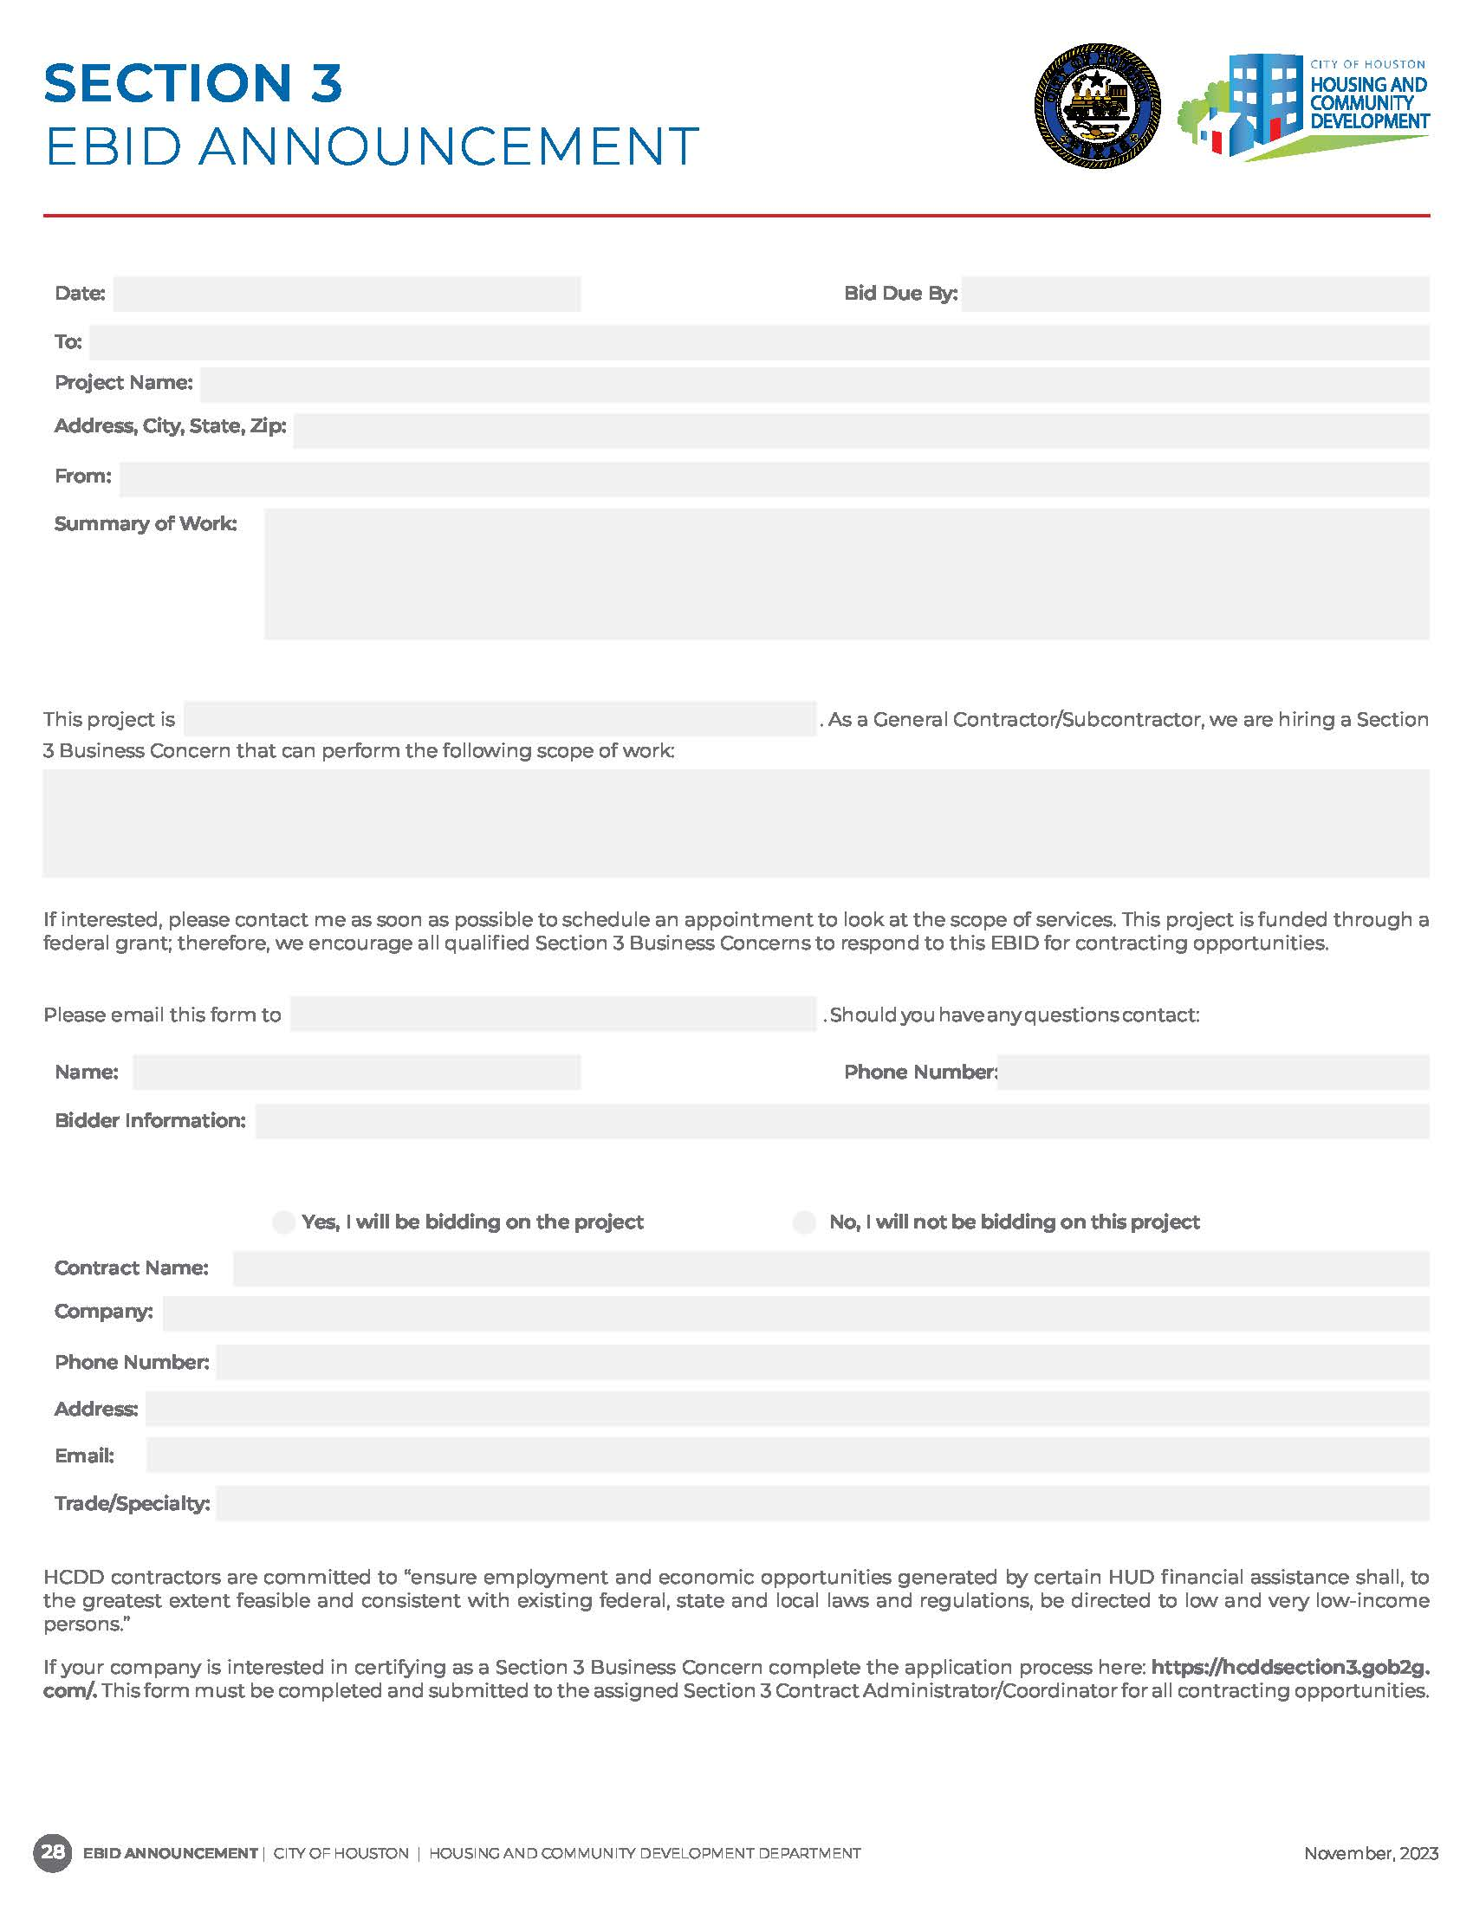
E-BID Announcement

Slide 28
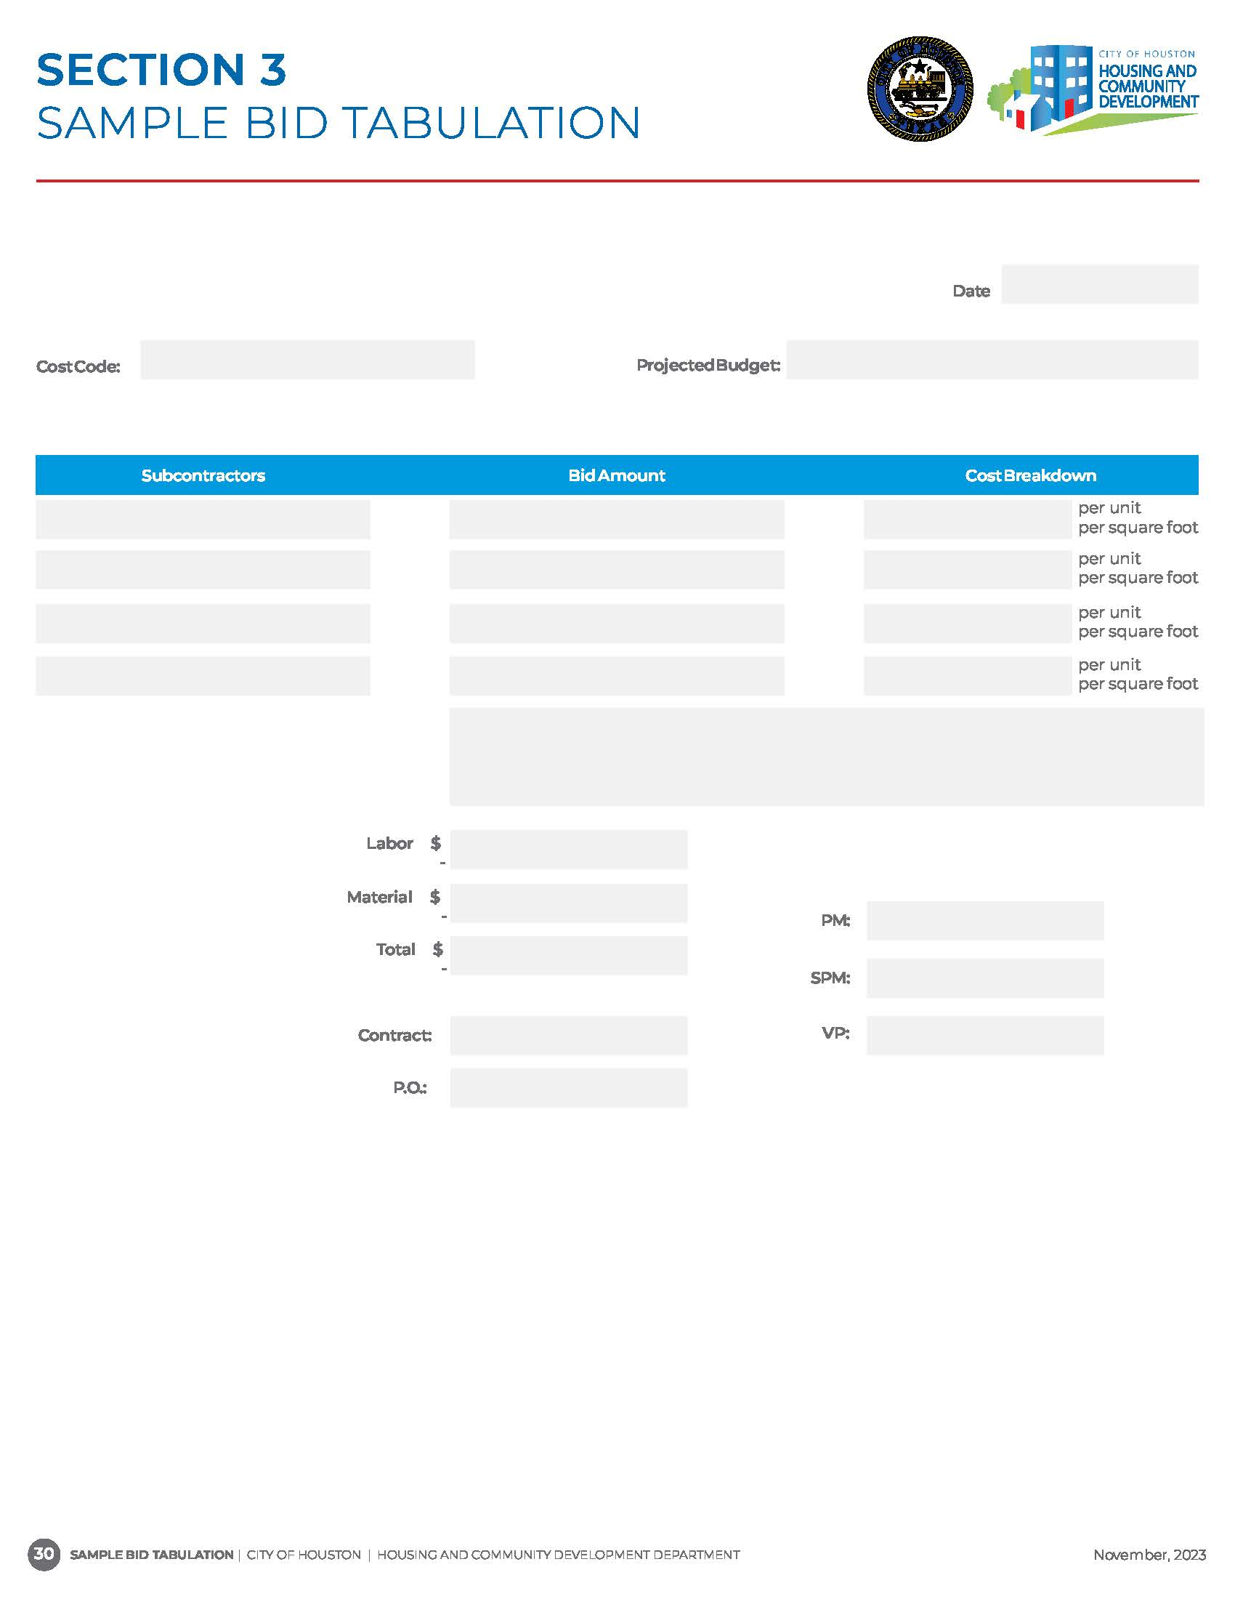
Sample Bid Tabulation

Slide 29
Employment Opportunity Announcement
(EOA) Requirements
When new hire opportunities arise throughout the duration of the project, an Employment Opportunity Announcement (EOA) must be submitted for dissemination to Section 3 Workers in HCDD’s online directory.
HCDD must be notified of the results.
Results must include:
(1) Name of the New Hire;
(2) Section 3 Classification; and
(3) Explanation, if a Section 3 Worker was not selected.

Slide 30
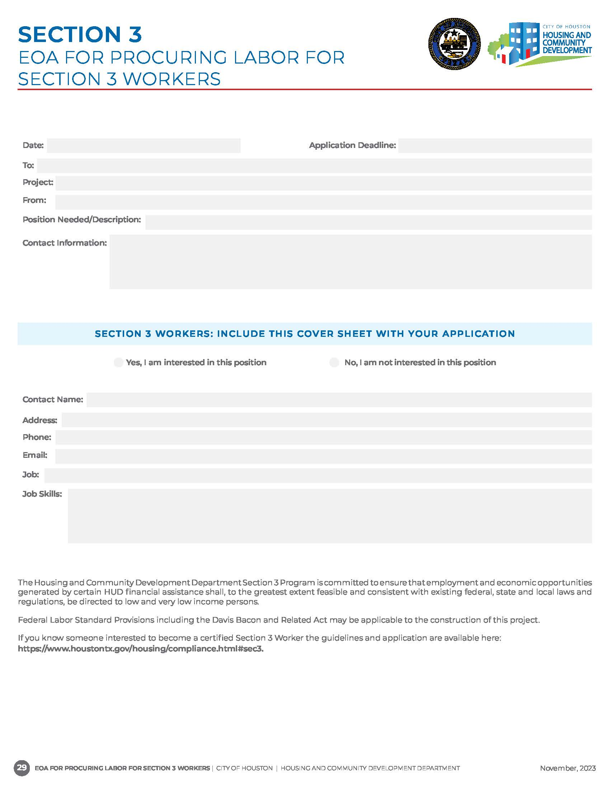
Employment Opportunity Announcement

Slide 31
POST AWARD ACTIVITIES

Slide 32
Contractor Requirements (Post Award)
A Section 3 Participation Plan with Letters of Intent (LOI) must be executed with Pre-Award Services prior to scheduling a pre-construction meeting and obtaining the Notice to Proceed (NTP).
A pre-construction meeting will be held with the Owner, Developer and Prime Contractor to discuss program rules and compliance expectations.
Contracted compliance personnel and subcontractors are strongly encouraged to attend the pre-construction meeting to ensure compliance requirements are understood before project activity commences.

Slide 33
Contractor Requirements (Post Award) Cont.
Section 3 covered contracts must include the federal regulations 24 C.F.R. Part 75.
DR17 Multi-family projects must include the Workforce Provision Appendix 15.
Federal General Services Administration’s System for Award Management (SAMs) and Texas Comptroller search results for each contractor and subcontractor performing on project is required at the execution of a contract and annually.
The Prime Contractor must ensure all contractors comply with numerical goal, reporting requirements, and review documents for accuracy before submitting to HCDD.
The Prime Contractor must report and submit any contract changes and/or change orders in LCP Tracker.
Section 3 signage must be onsite at the project in a size visible from street view.

Slide 34


Signage Template

Slide 35
COMPLIANCE FORMS PACKET
FOR CONTRACTS GREATER THAN $100,000.00

Slide 36
Compliance Forms Packet >$100,000.00
Compliance Forms must be submitted by contractors/subcontractors, no later than five (5) business days from execution of contract agreement.
Initial Requirements:
Compliance Cover Page: Captures vital contractor and subcontractor information and used to setup project in various systems.
Start of Work Notice: Must be submitted when work starts on a project.
Request for Contractor/Subcontractor Clearance: A verification that contractors and subcontractors are eligible to perform on federally funded projects.
SAM Results: Verification that contractors and subcontractors are not on the Excluded Parties List.*
Texas Comptroller: Verification that contractors and subcontractors are not on the Debarred Vendor List.*
Conflict of Interest: Verification that owner(s), developer, contractors, and subcontractors have no conflicting relationships.*
*SAM, Texas Comptroller Results, and Conflict of Interest are also required annually*

Slide 37
Compliance Forms Packet >$100,000.00 (cont’d)
Contractor’s Section 3 Compliance Certification: Must be completed by The Prime, contractors, and subcontractors acknowledging to abide with Section 3 regulations (24 C.F.R. Part 75).
Permanent Employee List: List of all employees who are employed prior to start of work on a project regardless if working on that particular project or not. Submitted once unless a change occurs.
First Source Hiring Agreement: Agreement to adhere to Section 3 policies when hiring individuals.
Workforce Analysis Form: Indicates the need or no need for new hires. (Forecast)
Internal Capacity Affidavit: Affidavit should be submitted once, and only if subcontractor does not have a need for lower-tier subs or new hires for the duration of the project.
Termination of Work Notice: Must be submitted when work ends on the project.

Slide 38
Compliance Forms Packet >$100,000.00
(Monthly Requirements)

Slide 39
Compliance Forms Packet >$100,000.00
Section 3 Monthly Utilization Plan
Monthly Internal Capacity Report
Monthly Activity Report
Lists the subcontractors utilized monthly on the project.
An attestation of internal capacity status.
Captures hours worked by both Section 3 and Non-Section 3 Employees for the length of the project.
*Required if and/or until Internal capacity is claimed*

Slide 40
Compliance Forms Packet >$100,000.00 (cont'd.)
Section 3 Monthly Labor Hours & Employee Report
Required from the Prime Monthly to track achievement of 25% Section 3 Worker and 5% Section 3 Targeted Worker Labor Goal.

Slide 41
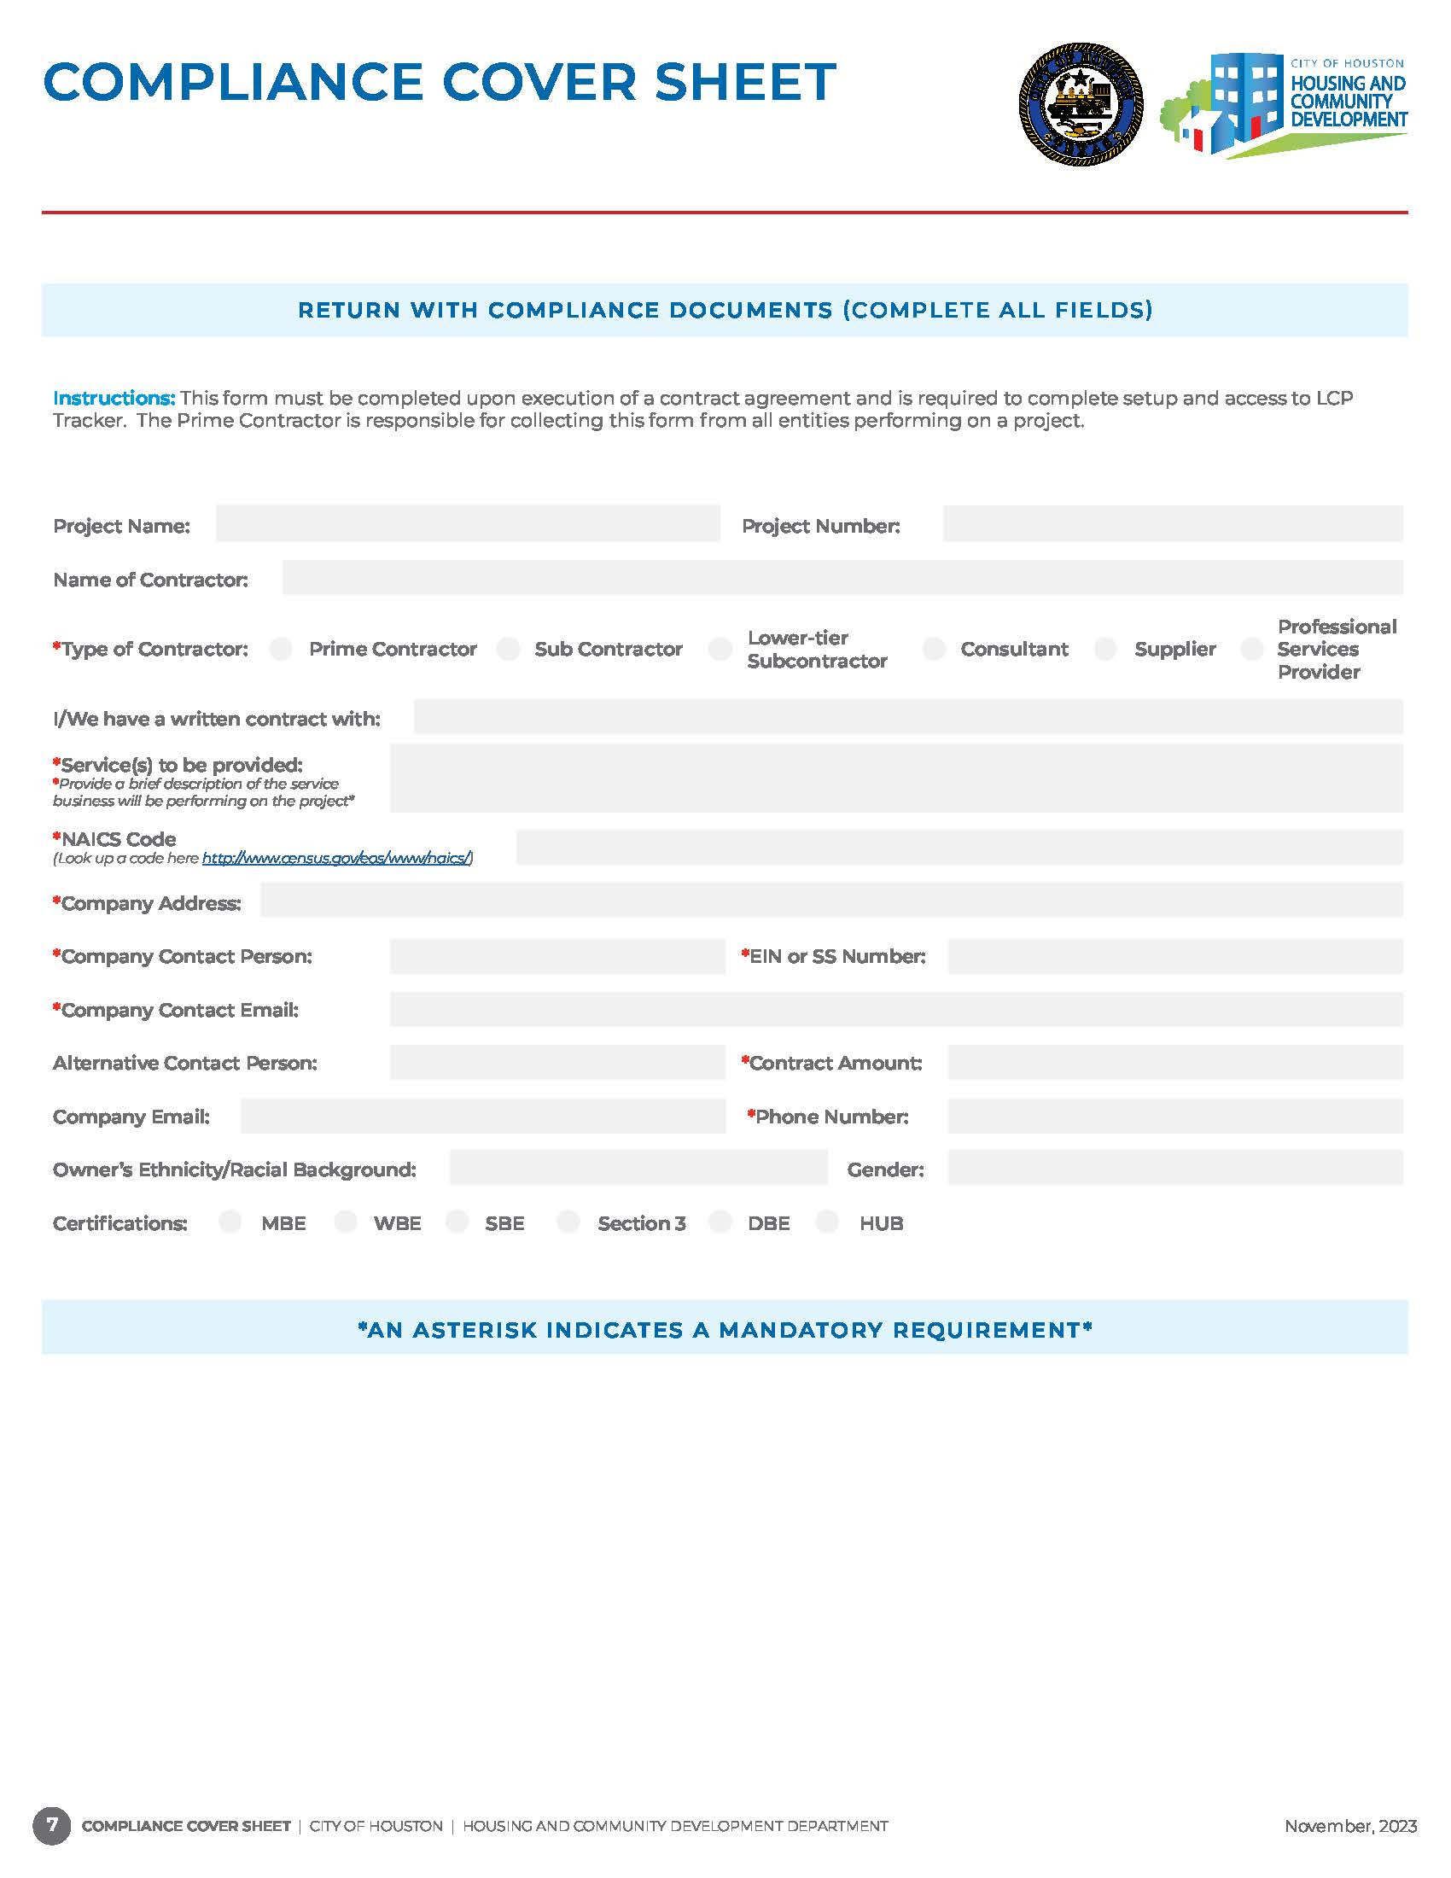
Located in Compliance Forms Packet.
Required from Prime Contractor, Subcontractors, and Lower-tier subcontractors.
Must be completed and uploaded to LCP Tracker along with executed contract within five (5) business days of the agreement.

Slide 42
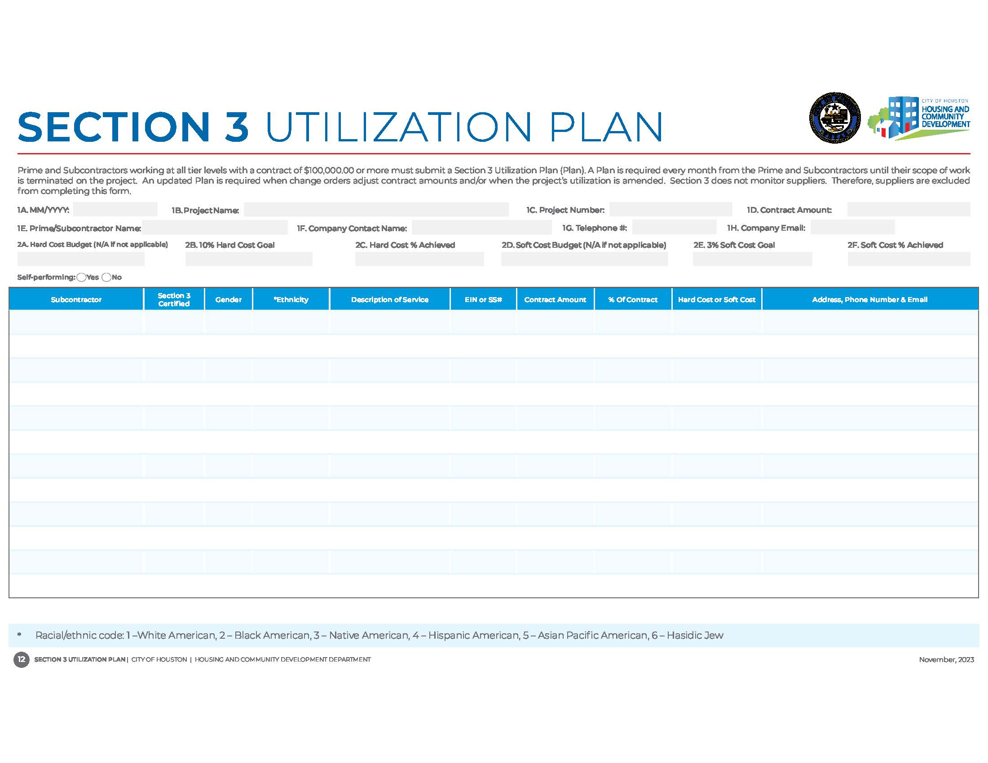
Section 3 Utilization Plan
Monthly requirement from the Prime, Subcontractor(s) and Lower-Tier Subcontractors with a contract of $100K and higher.
Prime Contractors and Subcontractors (over $100,000.00) must list all Subcontractors and Lower-Tier Subcontractors providing services on the project for the reporting month.
Tracks achievement of hard and soft cost Section 3 numerical goals.

Slide 43
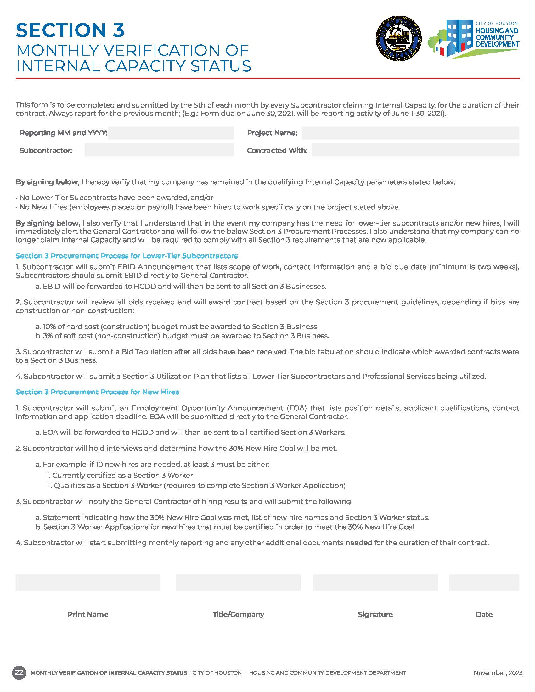
Monthly Internal Capacity Report
Required from subcontractors with a contract of $100k and higher who are self-performing the scope of work indicated in the contract.
Should subcontractor status change (I.e. a lower-tier or workers are hired), the subcontractor must inform Prime Contractor who in turn informs the assigned HCDD Contract Administrator.
Monthly compliance reporting submissions will be adjusted when the Internal Capacity status changes.

Slide 44
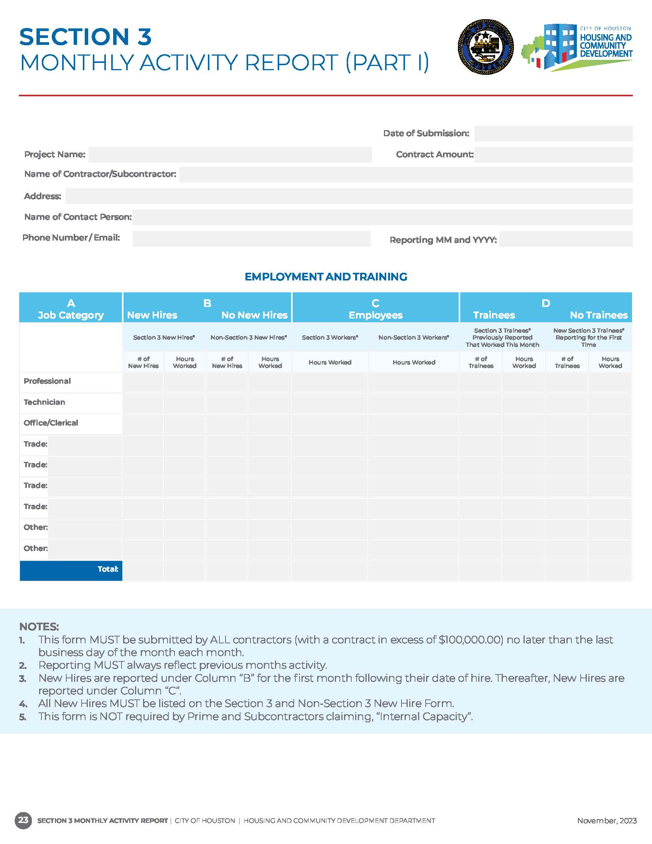
Section 3 Monthly Activity Report
Required from the Prime and subcontractors with a contract of $100k and higher who have lower-tier subcontractors to perform scope of work indicated in the contract.
Should subcontractor status change (I.e. Internal Capacity is claimed), the subcontractor must inform Prime Contractor who in turn informs the assigned HCDD Contract Administrator.
Monthly compliance reporting submissions will be adjusted when the subcontractors status changes.

Slide 45
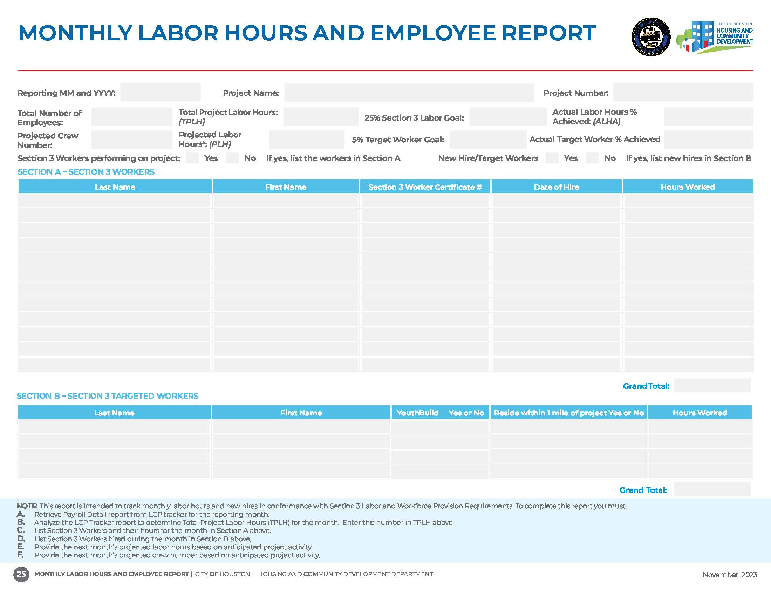
Monthly Labor Hour and Employee Report
Submitted by the Prime for all subcontractors working monthly on the project.
Tracks achievement of 25% Section 3 Worker and 5% Section 3 Targeted Worker Labor Goal requirements.
Excel version of the document available which includes formulas to assist with completing report.
Must use Payroll Detail Report in LCP Tracker to retrieve monthly project labor hours.

Slide 46
COMPLIANCE FORMS PACKET
(FOR CONTRACTS LESS THAN $100,000.00)

Slide 47
Compliance Forms Packet <$100,000.00
Contracts under $100,000.00 are not subject to Section 3 requirements.
Contractors with contracts less than $100,000 are only required to submit the below documents:
However, should your contract increase to $100,000.00 or higher, Section 3 requirements will be enforced.
Start of Work
(SOW)
Confirmation of Subcontractor Contract Amount Form (COSCA)
Termination of Work
(TOW)
Sam.gov Search Results for Business Name, Owner Name(s) and EIN
Conflict of Interest and Texas Comptroller Debarred Vendor Search Results
Contract Agreement, MSA, and/or Purchase Order

Slide 48
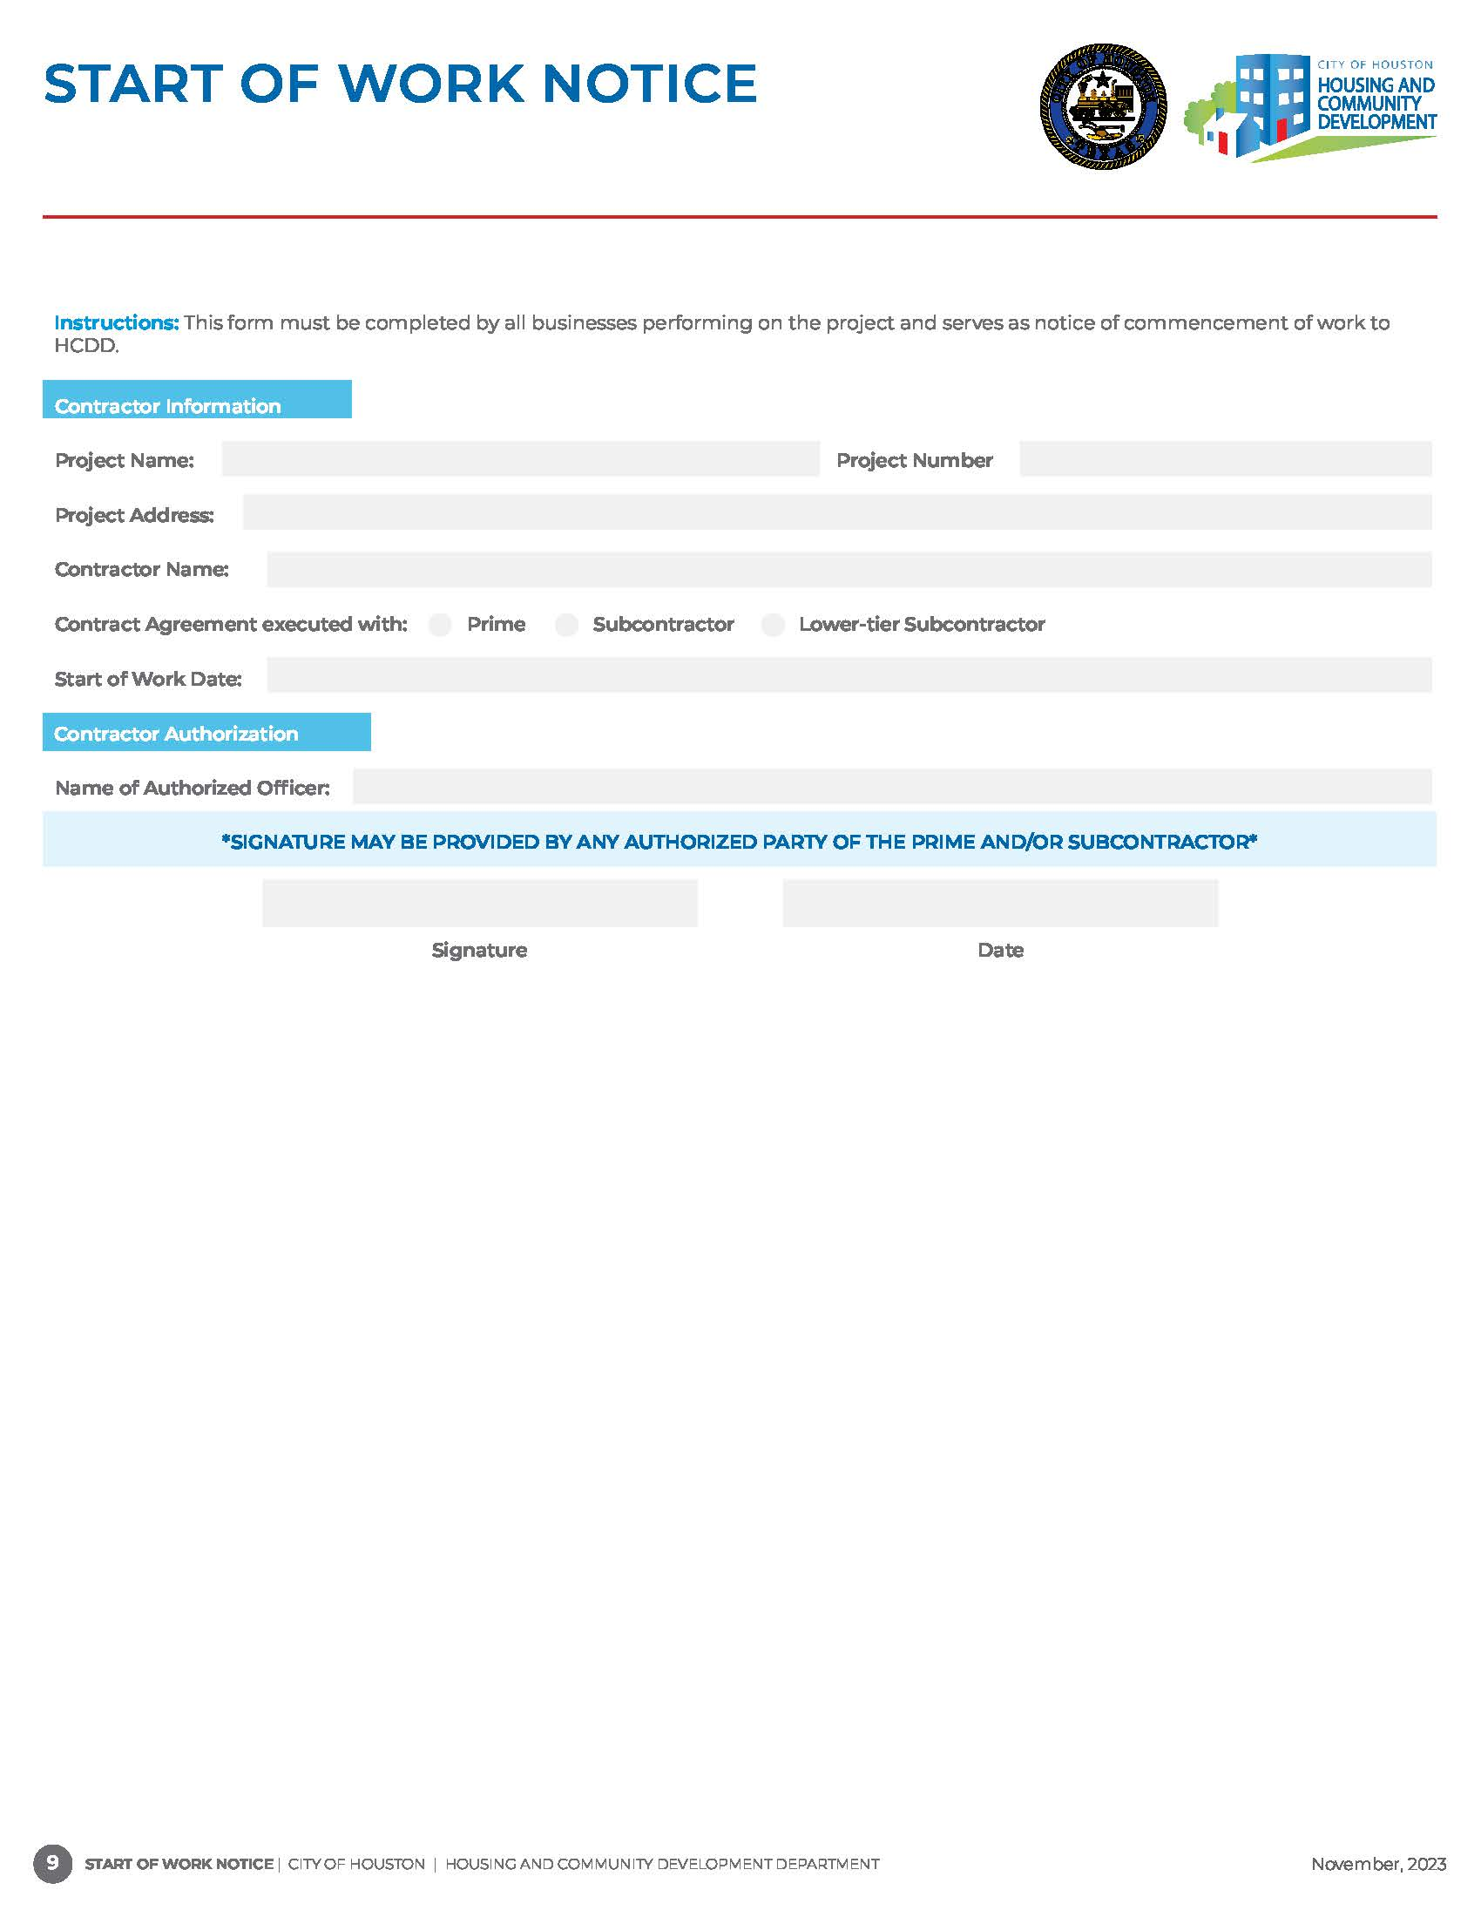
START OF WORK NOTICE
Required from the Prime Contractor, Subcontractors, and Lower-tier subcontractors.
Indicates to assigned Contractor Administrator when to begin monitoring and collecting applicable compliance documents from the Prime Contractor, Subcontractors, and Lower-tier subcontractors.

Slide 49
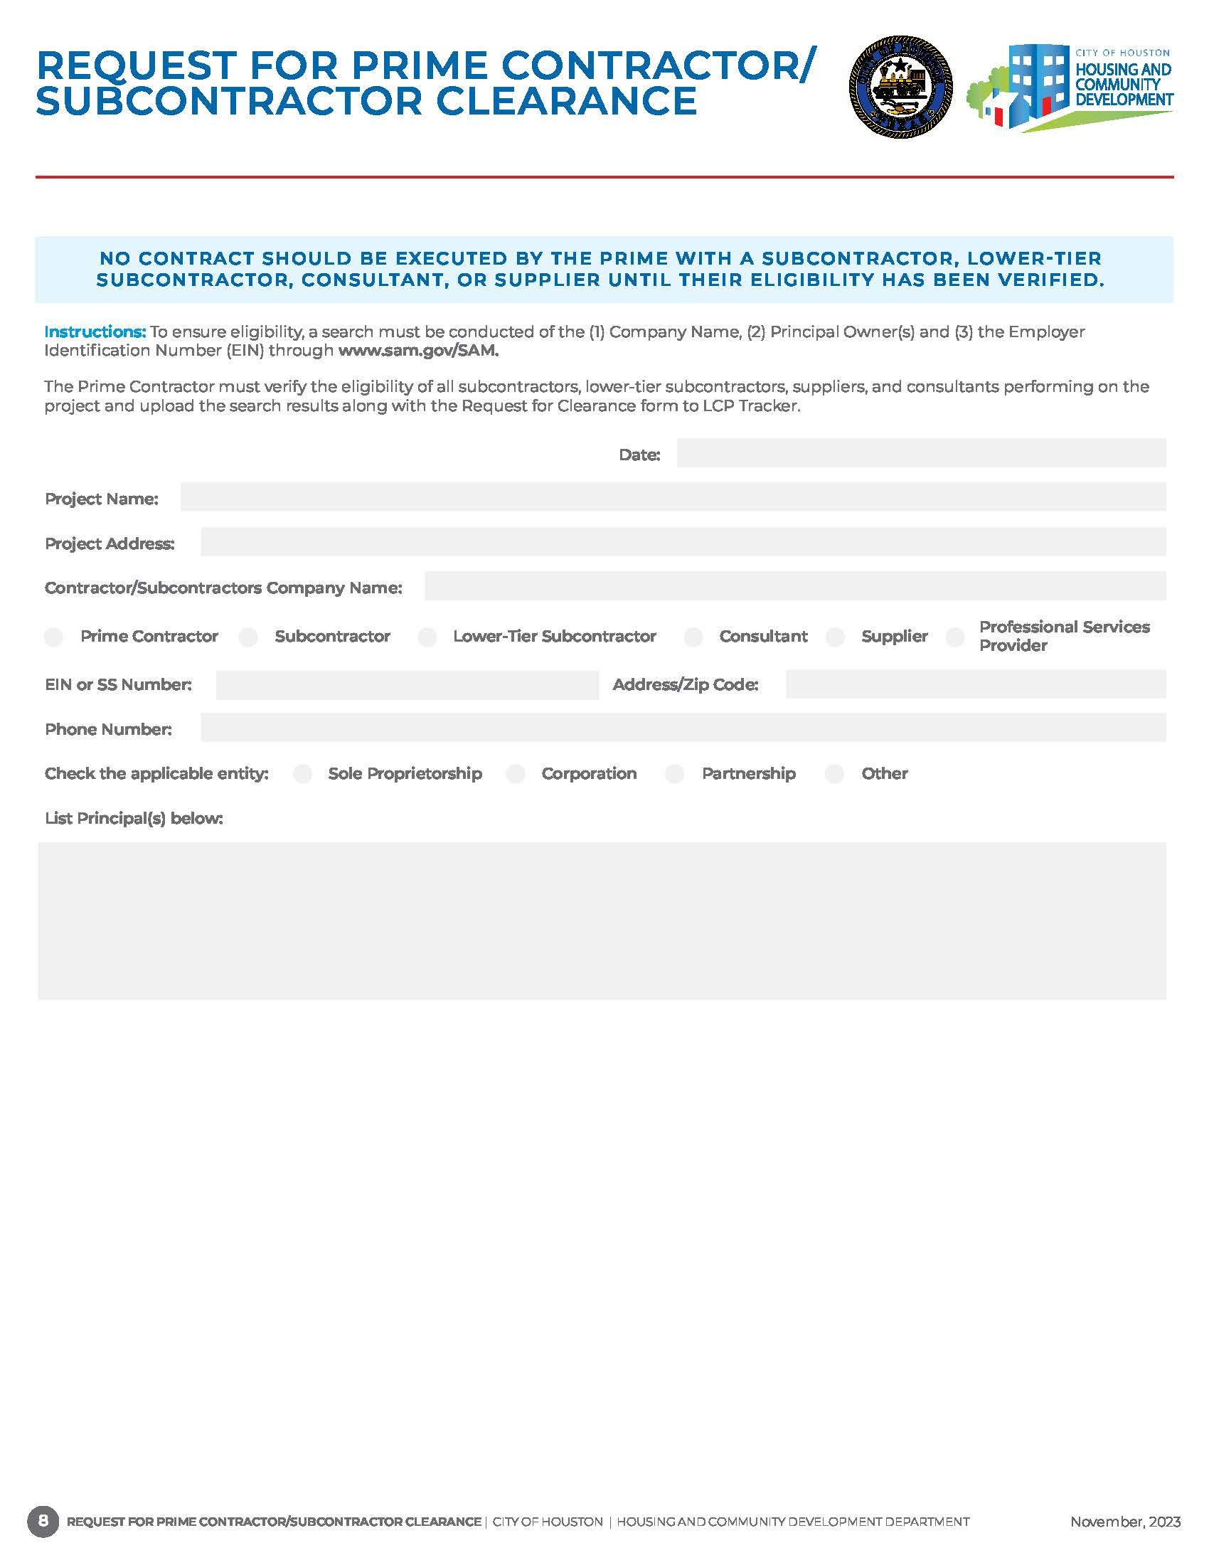
Required from the Prime Contractor, Subcontractors, and Lower-tier subcontractors with every executed contract agreement and annually.
Date and website details must be visible on search results for Business name, Owner(s) names and Employer Identification Number (EIN).

Slide 50
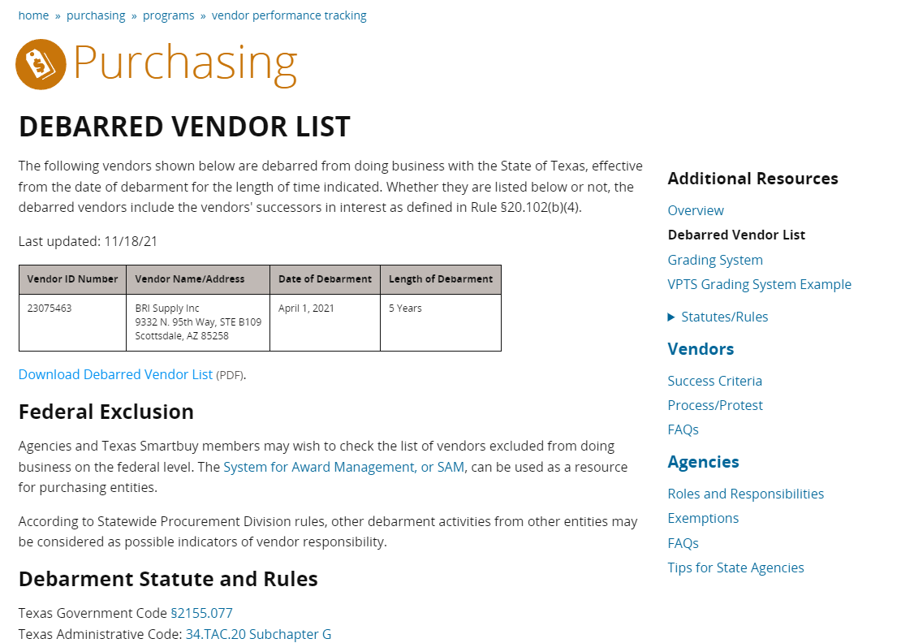
Required from the Prime Contractor, Subcontractors, and Lower-tier subcontractors with every executed contract agreement and annually.
Date and website details must be visible on search results.

Slide 51
Contract Agreements
A contract agreement, MSA, and/or Purchase Order is required from the Prime Contractor, Subcontractors and Lower-tier subcontractors performing on the project.
Executed contract agreements must be submitted within five (5) business days to HCDD.
All executed contracts must include:
Contract Date and Project Name
Contracting Parties Business Name(s)
Contract Amount
Scope of Work
Signatures and dates for Prime, Subcontractor and/or Lower-tier Subcontractors
Address(es) of home(s) - *Single Family Projects*
Federal Regulations (24 C.F.R § 75, 2 C.F.R. § 200.322) *for contracts $100K and higher*
DR17 Workforce Provisions Appendix 15 - *DR17 Multi Family Projects*

Slide 52
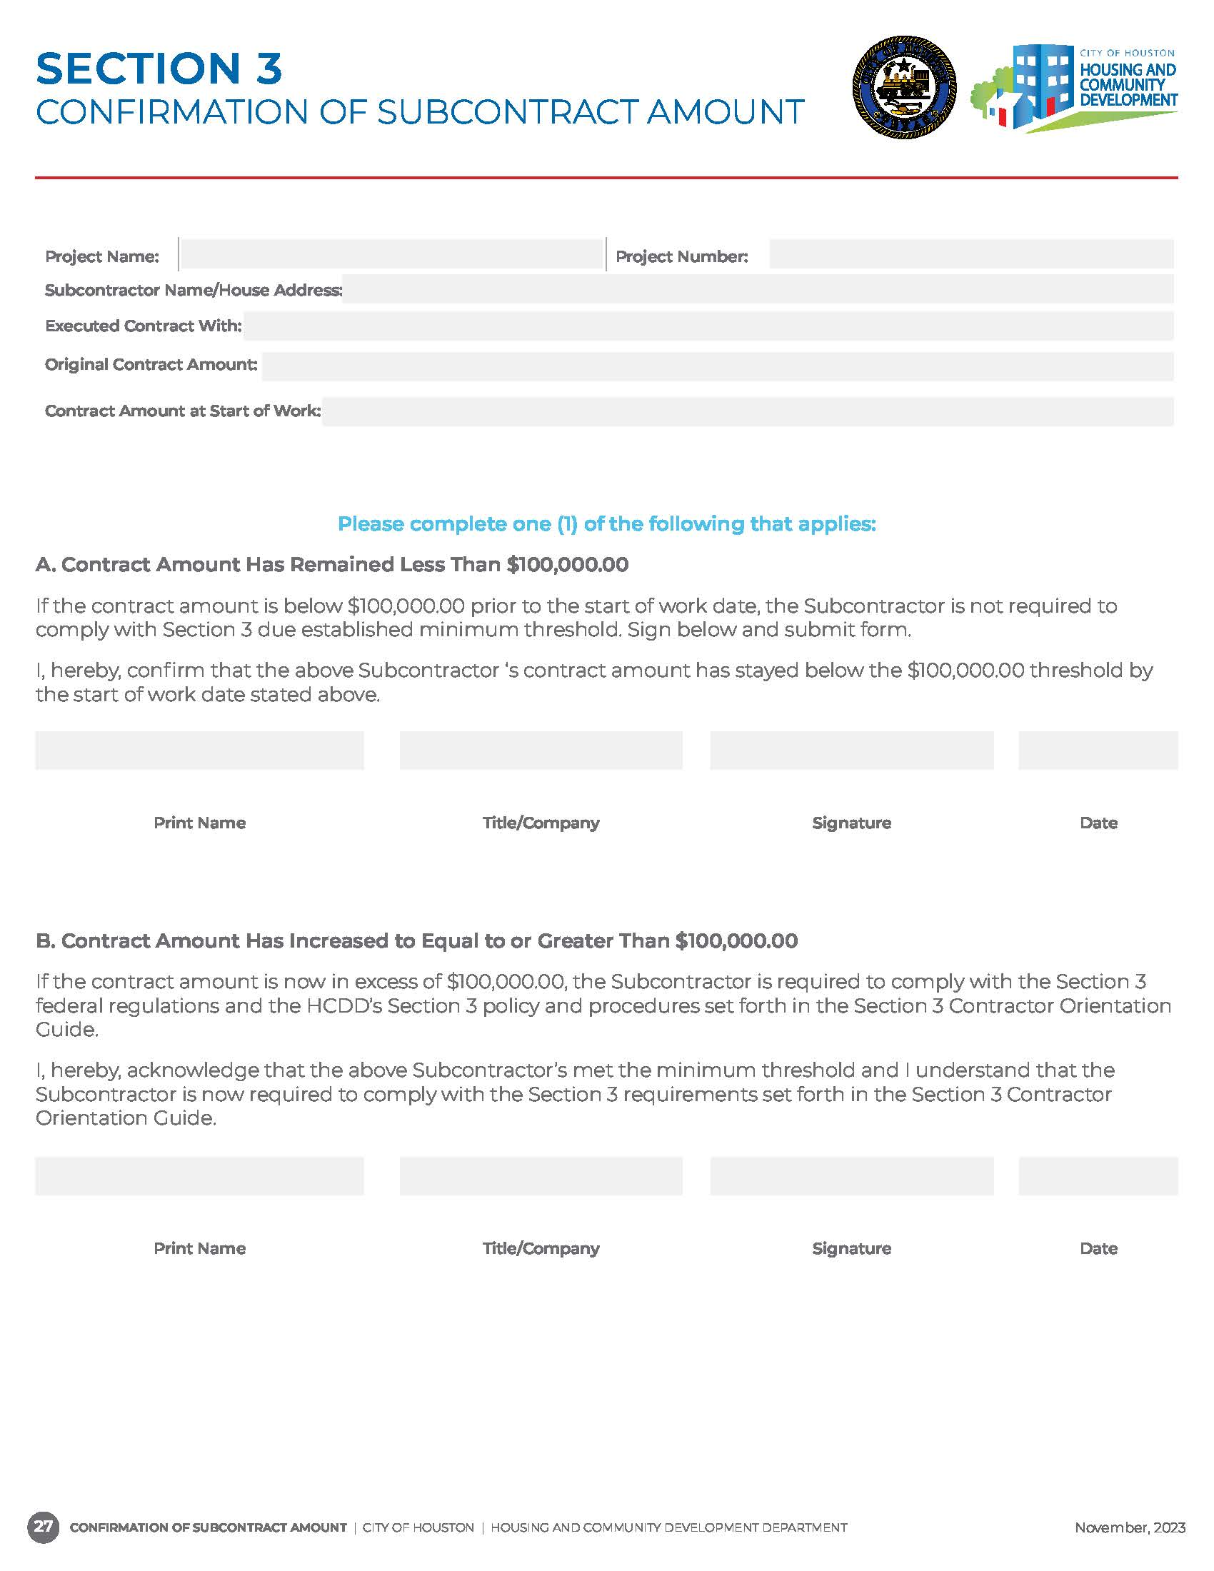
Required from Subcontractors, and Lower-tier subcontractors.
If the changes occur to increase the contract amount to equal or greater than $100,000.00, an updated form is required, and Section 3 monthly monitoring will begin.

Slide 53
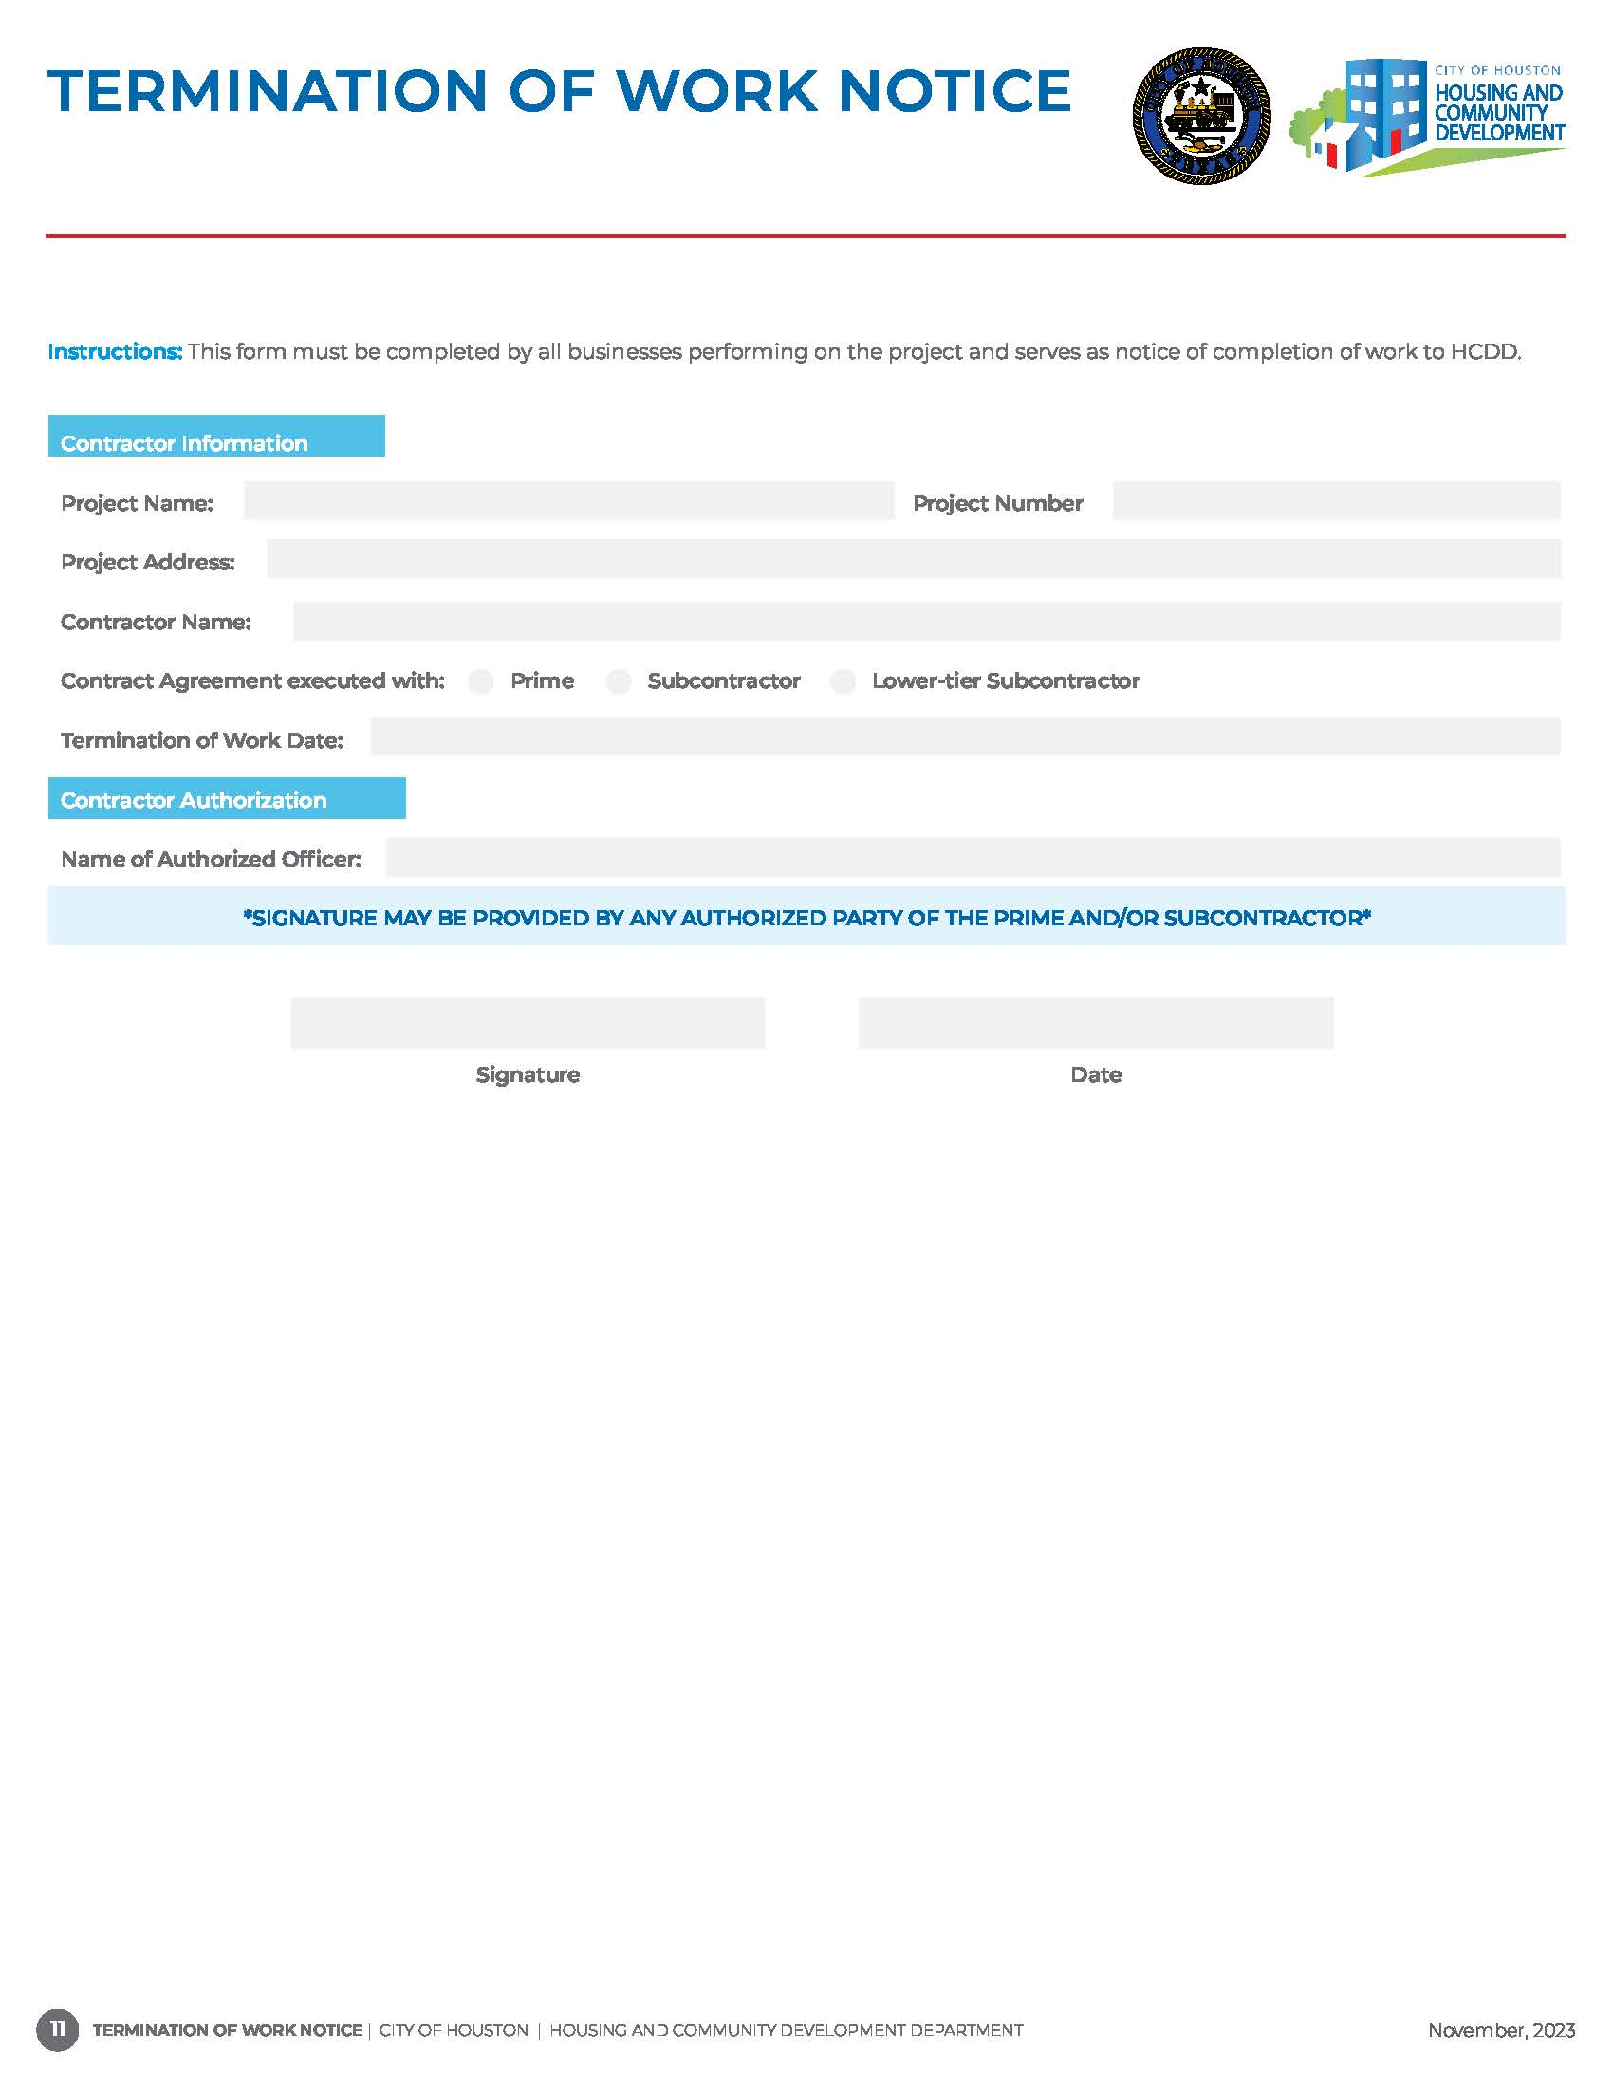
Required from the Prime Contractor, Subcontractors, and Lower-tier subcontractors.
Submitted when scope of work performed by Prime Contractor, Subcontractors, and Lower-tier subcontractors is complete.
Indication to assigned Contractor Administrator that applicable Section 3 compliance forms are no longer required.
Also, used to determine whether Prime Contractor, Subcontractor, and Lower-tier are excluded from annual search requirements (SAM, Texas Comptroller and Conflict of Interest).

Slide 54
Single Family Requirements
Subcontract Agreements are required for every subcontractor working on a project address. A Master Contract Agreement with Purchase Orders is also acceptable;
The Prime Contractor must submit a First Source Hiring Agreement, Section 3 Compliance Certification, Permanent Employee List (PEL), and Workforce Analysis Form one time only;
The Prime Contractor must conduct a SAM.gov search on each subcontractor and lower-tier subcontractor performing on the project (Company Name, Owner Name(s) and EIN);
The Prime Contractor will submit a Contract Cover Sheet, Section 3 Utilization Plan (UP), Texas Comptroller Debarred Vendor, Conflict of Interest Form, Start of Work (SOW) and Termination of Work (TOW) Notices for each subcontractor and lower-tier subcontractor performing on each project address;

Slide 55
Single Family Requirements
Section 3 Utilization Plan and Monthly Activity Reports are required every month following the SOW date for each project address;
All subcontractors and lower-tier subcontractors must submit a Confirmation of Subcontractor Contract Amount Form for each project address;
The Prime Contractor must inform HCDD of any subcontracting or employment opportunities prior to awarding or hiring by forwarding an EBID Announcement (EBID) or Employment Opportunity Announcement Form (EOA) to our office for dissemination to our certified Section 3 Workers and Section 3 Business Concerns.

Slide 56
LCP TRACKER AUDITING SYSTEM

Slide 57

Following a Pre-Construction and/or Kick Off Meeting, a Contract Administrator will create the project profile and assign the Prime Contractor as the Prime Approver in LCP Tracker.
The information required to setup a Prime and subcontractor assignments in LCP Tracker is captured on the Compliance Cover Sheet found in the Compliance Forms Packet.
The Prime Contractor is responsible for setting up and assigning each subcontractor to the project in LCP Tracker.
Subcontractors must be assigned to a project in order to submit required compliance documents.
The Prime Contractor is responsible for reviewing and approving compliance document uploads submitted by subcontractors in LCP Tracker.
LCP Tracker captures Section 3 Worker certification status and project labor hours.

Slide 58
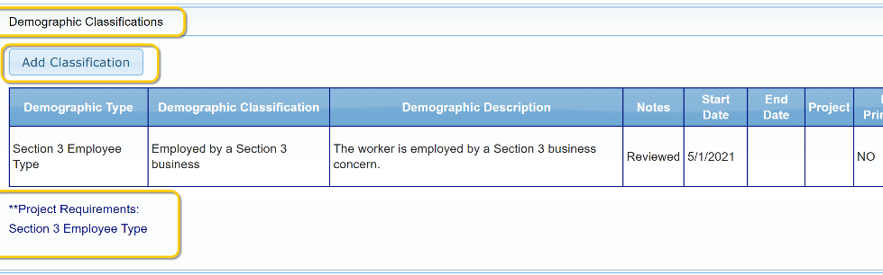
LCP Tracker
Under the Employee Profile Page, the subcontractor will:
Select Demographics Classifications>Add Classification>Demographic Type>Section 3 Employee Type>Demographic Classification>Enter Start Date>Done>Save.
Demographic Classification where the new Section 3 Employee Type is located.

Slide 59
LCP Tracker
Prime Contractor Steps to Assign a Contractor to Project
Step 1
Step 2
Step 3
Step 4
Step 5
Step 6
Log in https://prod.lcptracker.net/WebForms/Login.aspx
Select “Set Up” from the toolbar tab. Then, click Add/Edit Contractors.
To add a “New” contractor, enter the contractor information and save. If the contractor already has an account, and you cannot locate their profile, add the contractor and enter the “Contractor ID” as shown on the contractor cover sheet.
Go to “Set Up” and click “Contractor Assignment”
Click “Add New Assignment”, select project and contractor adding.
Select project, enter field info and press save.

Slide 60
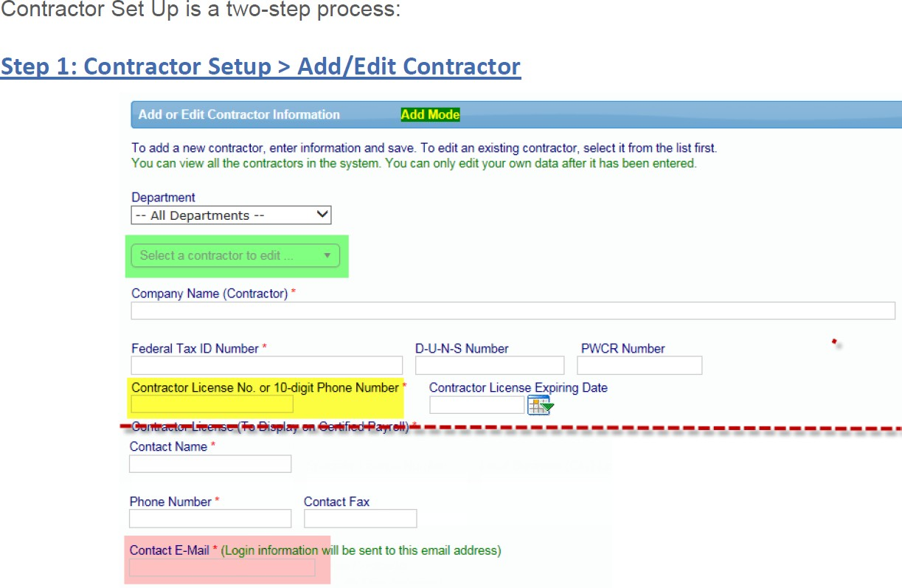
Contractor Set Up is a two-step process

Slide 61
LCP Tracker Steps to Upload Documents
Step 1
Step 2
Step 3
Step 4
Document must be in electronic format. Document type must be pdf, txt, xls, doc, and/or tif
Go to Set Up and select Add/Edit Document
Enter Required Fields
Upload Document under appropriate file name

Slide 62
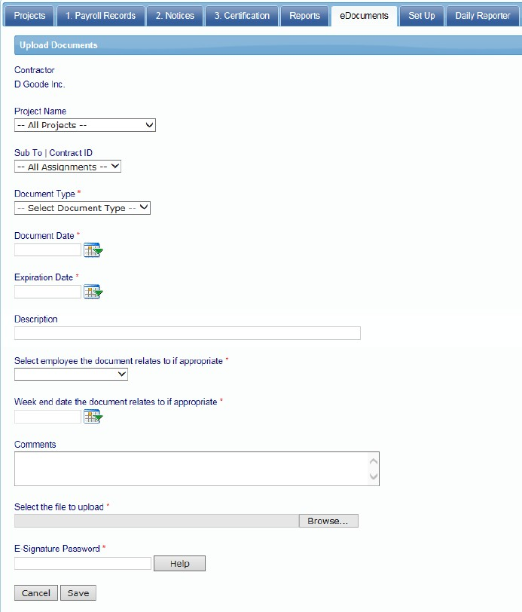
Steps to Upload Documents

Slide 63
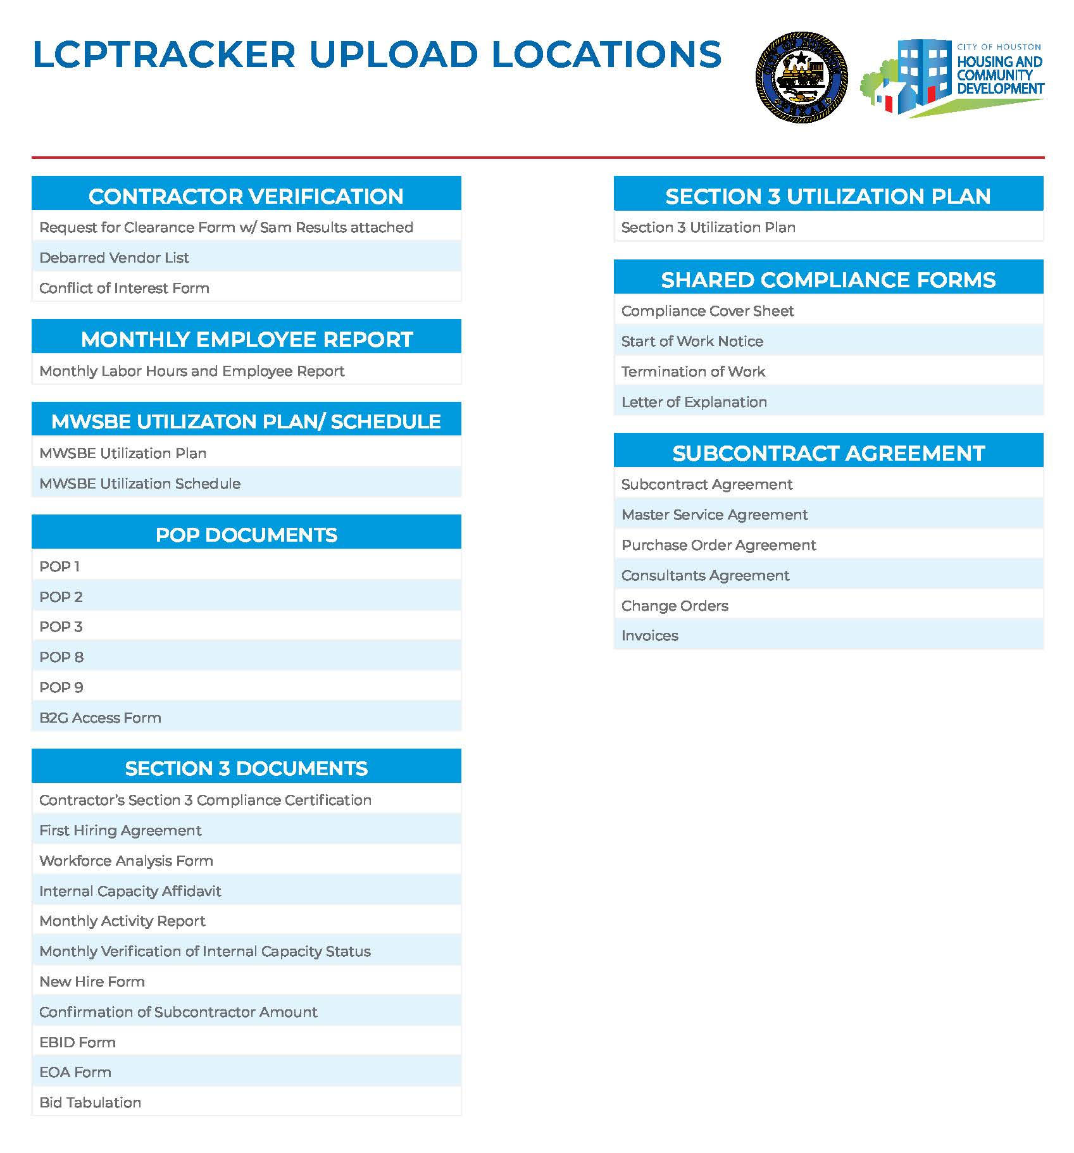
Document Upload Locations

Slide 64
DEVIATION REQUEST

Slide 65


Deviation Request Requirements
A Deviation Request is required to add or remove a certified Section 3 Business from the approved Section 3 Participation Plan.
A written request from the Prime Contractor must be submitted to the assigned Contractor Administrator for review to deviate from the approved Section 3 Participation Plan.
The Prime Contractor must provide evidence to confirm subcontractor was notified and acknowledges the deviation process.
The Deviation Request must include the Who, What, When and Why.

Slide 66
ONGOING MONITORING

Slide 67
Ongoing Monitoring
Monthly site visits will be conducted randomly to monitor project activities and contractors’ participation.
The Prime Contractor will be provided with a Compliance Status Report (CSR) *by the 5th working day of each month* which indicates if the project is compliant or non-compliant with program rules. A deadline will be given for correction of non-compliant items.
HCDD Contract Administrators are required to submit reports to the General Land Office and HUD quarterly and annually that capture Section 3 Workers and Targeted Workers, executed contracts, and Section 3 Businesses with construction and non-construction related contracts.
Submission of required compliance documents in a timely manner is critical to ensure accurate and reliable reporting.
*If the 5th falls on a weekend or holiday, reports will be provided on next business day*

Slide 68
CONTRACTORS PERFORMANCE

Slide 69
Compliance Red Flags
Unresponsive Prime Contractors and compliance administrative personnel.
Failure to submit change orders.
Failure to meet numerical goal requirements and demonstrate acceptable good faith efforts.
Failure to submit timely required compliance documents.
Compliance Monitor conducts site visits and observes contractors performing that are not included on a Utilization Plan and/or have not submitted required compliance documents.
Documents not uploaded under the correct document type in LCP Tracker.
Contractors don’t submit timely corrective actions.

Slide 70
SUBTANTIAL
NON-COMPLIANCE
Termination of Contract
Payment Withholding
Suspension, Debarment, Suspension or Limited Denial of Participation
At any time, failure to comply with contractual agreement terms can result in HCDD temporarily suspending and/or termination of the contract.
Failure to comply with Section 3 program rules, will result in withheld payment draws.
Upon termination, HCDD will also include Contractor(s) on Nationwide Debarred and Suspended List of Contractors.

Slide 71
PROJECT
CLOSEOUT EVALUATION

Slide 72
PROJECT CLOSEOUT EVALUATION
REPORT
Deficiencies to meet numerical goal and compliance requirements may be corrected by the Prime within fourteen (14) business days following receipt of the closeout report.
Conducted to evaluate the Prime contractor's achievement of Section 3 numerical goals and compliance requirements.
Lack of corrective action will be deemed as the Prime's inability or unwillingness to do so.

Slide 73
SECTION 3
FAQs

Slide 74
Section 3 FAQs
How are the terms “low-income” and very low-income determined?
Low- and very-low-household income limits are determined annually by HUD. These limits are typically established at 80 percent and 50 percent of the median income for each locality by household size or the number of people residing in one house.
When does a business certification expire?
A certified business must recertify after 3 years.
What is YouthBuild?
YouthBuild is a community-based pre-apprenticeship program that provides job training and educational opportunities for at-risk youth ages 16-24 who have previously dropped out of high school.
How does Section 3 differ from the Minority Business Enterprise/Women Business Enterprise programs?
Section 3 is both race and gender neutral. The standards provided under this regulation are based on income-level and location. Section 3 regulations were designed to encourage recipients of HUD funding to direct employment, training, and contracting opportunities to low-income individuals, and the businesses that employ these persons within their community regardless of race and/or gender.
Can a non-profit organization be considered a business concern for the purposes of Section 3?
Yes. A non-profit organization can be a business concern.
What if my agency does not meet all benchmark goals for employment or contracting?
If reporting indicates that the agency has not met the Section 3 benchmarks, the agency must report in a method prescribed by HUD program offices on the qualitative nature of its activities and those its contractors and subcontractors pursued per 24 CFR § 75.15(b) and § 75.25(b).

Slide 75
Section 3 FAQs
What are outreach efforts to generate numerical goal achievements?
Hosting or visiting local job fairs.
Utilizing e-bids & EOAs for all open opportunities that are a part of the project.
Guiding Section 3 workers to services supporting work readiness and retention (work readiness activities, interview clothing, test fees, transportation, childcare).
Engaging in outreach efforts to identify and secure bids from Section 3 business concerns.
Providing technical assistance to help Section 3 business concerns understand and bid on contracts.
Dividing contracts into smaller jobs to facilitate participation by Section 3 business concerns.
Do the Section 3 requirements apply to material only contracts?
No. Section 3 does not apply to material only contracts or those that do not require any labor. For example, a contract for office or janitorial supplies would not be covered by Section 3. In this example, Section 3 would be encouraged but not required. However, a contract to replace windows that includes the removal of existing windows, and the installation of new windows would be covered due to the involvement of labor.
What is the relationship between Section 3 and Davis Bacon requirements?
Compliance with Section 3 must be achieved consistent with the requirements of Davis-Bacon. Certain construction contracts are subject to compliance with the requirement to pay prevailing wages determined under the Davis-Bacon Act (40 U.S.C. 3141 et seq.) and implementing U.S. Department of Labor regulations in 29 CFR Part 5.
What are the responsibilities of recipient agencies under Section 3?
Recipients are required to ensure their own compliance and the compliance of their contractors/subcontractors with the Section 3 regulations, as outlined at 24 CFR part 75. These responsibilities include but are not limited to the following: Facilitating the training and employment of Section 3 workers, facilitating the award of contracts to Section 3 business concerns, ensuring compliance and meeting numerical benchmarks, implementing procedures to comply with the requirements of Section 3.
Will there be changes to the benchmark requirements?
The Secretary of Housing and Urban Development is required in the Benchmark Notice published in the Federal Register to review and update the Benchmarks by Federal Register notice no less frequently than once every three years.

Slide 76
RESOURCE LINKS

Slide 77
Resource Links
HUD
https://www.hud.gov/section3
Federal Regulations
https://www.govinfo.gov/content/pkg/FR-2020-09-29/pdf/2020-19185.pdf
Section 3 FAQs
https://www.hud.gov/sites/dfiles/documents/19580_SECTION3.PDF
HCDD Section 3 Website
https://www.houstontx.gov/housing/section3documents/Section_3_FAQs.pdf

Slide 78


Comments & Questions

Slide 79


Slide 80
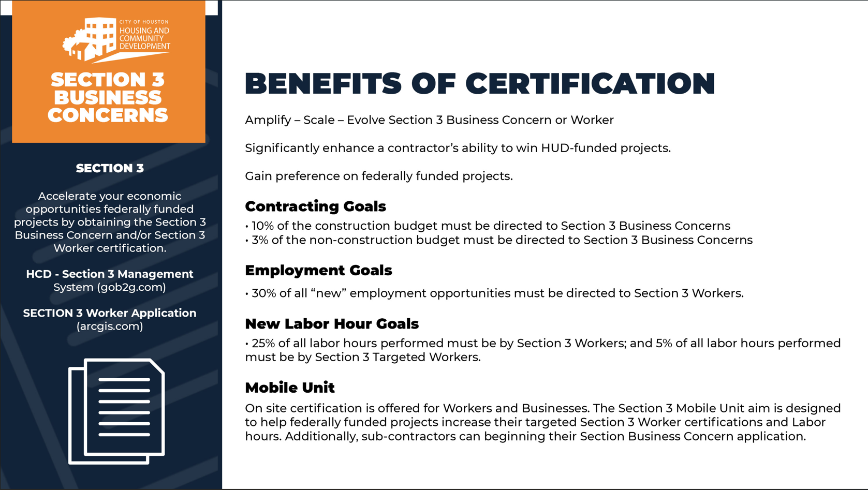

Slide 81


