Slide 1
Portfolio Compliance
Technical Assistance Training
January 25, 2023

Slide 2


Division Contact Information
Keith W. Bynam
Interim Director
Chrystal Boyce Division Manager
2100 Travis St., 9th Floor, Houston, TX 77002
www.houstontx.gov/housing

Slide 3



Our Team Members
Kionnedra Johnson
Senior Contract Administrator
Kionnedra.Johnson@houstontx.gov
832.394.6294
Johnny Cratic
Contract Administrator
Johnny.Cratic@houstontx.gov
832.394.6190
Ashley Lewis
Contract Administrator
Ashley.Lewis@houstontx.gov
832.394.6085
Karen Franklin
Community Involvement Coordinator
Karen.Franklin@houstontx.gov
832.394.6160
Professionals committed to providing resources that enable exceptional program compliance.

Slide 4

About Us
Program requirements are designed to increase the supply of affordable housing for a sustained period, by capping rents at affordable levels and restricting occupancy to low- and very low- income households.
This training describes specific requirements that apply to assisted properties during the period of affordability.
“Talent wins games, but teamwork
and intelligence win championships”

Slide 5
TENANT CERTIFICATION

Slide 6
Tenant Certification
No required form
Form used must gather sufficient information about the household size, income, and assets
Section A:
Tenant Eligibility
Step 1- Screening: Completing Application
City of Houston Applications-(contains basic acceptable data)
HUD and TDHCA applications are also accepted
Conventional TAA rental application will not gather sufficient information
If using a TAA application, also use a TAA Supplemental Application

Slide 7
Tenant Certification
Screening Reminders:
Applications must include Social Security numbers of all household members age 6 and older
Spouses may submit a joint application
Applications must be completed entirely
No whiteout on applications
***Gather the same information during recertification as required during initial certification***
Section A:
Tenant Eligibility
Step 1- Screening: Completing Application

Slide 8
Tenant Certification
Determine the number of members in the household; and
Determine the restriction level for the household
Then, refer to Income Limits to obtain the maximum allowable income for the household
Section A:
Tenant Eligibility
Step 2- Screening: Household Composition

Slide 9
Income Limits Example
% of AMI | 1 Person | 2 Persons | 3 Persons | 4 Persons
30% | $18,650 | $21,300 | $23,950 | $26,600
50% | $31,050 | $35,450 | $39,900 | $44,300
60% | $37,260 | $42,540 | $47,880 | $53,160
80% | $49,600 | $56,700 | $63,800 | $70,850
  Current Income Limits can be found at:
  http://www.hudexchange.info/programs/home/home-income-limits/

Slide 10
Tenant Certification
Household member classifications:
Head
Spouse
Co-Head
Dependents
Section A:
Tenant Eligibility
Step 2- Screening: Household Composition

Slide 11
Tenant Certification
Who counts as a household member:
Year-round tenant applicants
Anyone residing in the home more than 50% of the year
Members temporarily away (Children and Adults)
Unborn Children(List as Child on Application and/or TIC form)
Children under joint custody who are present more than 50% of the year
Children in the process of being adopted
Children temporarily absent due to placement in foster care
Foster Adults and Foster Children (Effective Aug 2013)
Section A:
Tenant Eligibility
Step 2- Screening: Household Composition

Slide 12
Tenant Certification
For HUD/HOME programs, a household is not eligible for occupancy if the household contains a full- or part-time student at an institution of higher education and all of the following statements are true for the student:
Is under the age of 24;
Is not a veteran of the United States military;
Is unmarried (if married, the couple cannot live apart from each other);
Does not have a dependent child who resides with the household member at least 50% of the time;
Is not a person with disabilities receiving Section 8 assistance as of November 30, 2005;
Is not otherwise individually eligible or has parents who (individually or jointly) are not income eligible to receive Section 8 assistance, unless the student can demonstrate his or her independence from his/her parents*.
Is not residing with parents who are receiving or applying for Section 8 assistance.
Section A:
Tenant Eligibility
Step 2- Screening: Household Composition
Student Eligibility

Slide 13
Tenant Certification
To determine a student's independence from his or her parents, the owner/manager should use the following criteria:
The individual must be of legal contract age under state law.
The individual must have established a household separate from parents or legal guardians for at least one year prior to application for occupancy, or the individual must meet the U.S. Department of Education's definition of an independent student. Per definition, an independent student is:
At least 24; Married; A graduate or professional student; A veteran; A member of the armed forces; An orphan; A ward of the court; Someone with legal dependents other than a spouse; An emancipated minor; or Someone who is homeless or at risk of being homeless.
The individual must not be claimed as a dependent by parents or legal guardians pursuant to IRS regulations.
The individual must obtain a certification of the amount of financial assistance that will be provided by parents, signed by the individual providing the support. This certification is required even if no assistance will be provided.
Section A:
Tenant Eligibility
Step 2- Screening: Household Composition
Student Eligibility

Slide 14
Tenant Certification
Who does not count as a household member:
Live in aides/attendants
Children under joint custody in the unit less than 50% of the time (Less than half the year)
Section A:
Tenant Eligibility
Step 2- Screening: Household Composition

Slide 15
Tenant Certification
Does the household look eligible? *
IF NO: Offer the household an unrestricted unit/market unit, if available.
IF YES: Obtain tenant authorization and release of information from all household members 18 and older.
OR Place them on a waiting list
* Necessary to verify income and assets disclosed
Section A:
Tenant Eligibility
Step 2- Screening: Household Composition

Slide 16
Tenant Certification
Income inclusions
Common Sources:
Income from earnings
Income from assets
Self Employment
Social Security Benefits
  Income from earnings include overtime, commissions, fees, tips, and bonuses.
  Be sure to include the gross amount of each source of income.
  Include salaries received from a family- owned business.
  Include social security payments for all HH members regardless of age.
  If the social security is reduced to adjust for a prior overpayment, count the amount that is being provided after the adjustment.
Section B:
Determining Income and Assets

Slide 17
Tenant Certification
Income inclusions
Child Support
Workers Compensation
Unemployment
Welfare
Recurring Monetary Contributions
Military Pay
Retirement Funds and Pensions
  Include court ordered child support unless household can certify it is not being received and shows documentation that a reasonable effort has been made to collect child support.
  Count unemployment and welfare payments (AFDC or TANF) as if the HH will receive for the entire year.
Section B:
Determining Income and Assets

Slide 18
Tenant Certification
Unusual sources of income:
Delayed periodic payments received because of delays in processing unemployment, welfare, or other benefits.
Payments from annuities and insurance policies.
Actual income distributed from trust funds that are not revocable by or under the control of any member of the tenant family.
Alimony, severance pay, disability, death benefits and other similar types of periodic receipts.
Section B:
Determining Income and Assets

Slide 19
Tenant Certification
Employment earnings from children under the age of 18 (Unless Emancipated)
Payments under Section 8 or any comparable rental assistance program.
Deferred periodic payments from Social Security received in a lump sum.
Earnings in excess of $480 for full time students 18 and older, who are not the head, co- head or spouse of either.
Adoption assistance payments in excess of $480 per adopted child.
Income of a live-in aide
Loans (business loans are not excluded)
Section B:
Determining Income and Assets
Income Exclusions

Slide 20
Tenant Certification
Temporary non- recurring or sporadic income.
SNAP (Food Benefit)
Contributions that are paid directly to a child care provider by persons not living in the unit.
Special pay to a family member in the Armed Forces who is exposed to hostile fire. (Do not confuse this with hazardous duty; hazardous duty pay is included).
Amounts received under training programs funded by HUD.
A resident service stipend (not to exceed $200 per month)
Section B:
Determining Income and Assets
Income Exclusions

Slide 21
Tenant Certification
Firsthand:
Paychecks, social security awards letters, bank statements
Third-party written:
Sent directly to third-party source via mail or fax
Faxes must include the company name and fax number
If mailed, maintain envelope in which the verification was returned
Oral (telephone) clarification only
**Resident screening services cannot be used to document household income.
  The only acceptable form of verification for military pay is leave and earnings statement.
  HUD 4350.3 par. 3-31 “ Owners must send verification forms directly to the source, not through the applicant”
Section B:
Determining Income and Assets
Types of Income Verifications

Slide 22
Tenant Certification
(Hourly wages x 2080 for full time employment) OR (Hourly wages x number of hours worked per week)
Weekly wages x 52
Biweekly wages x 26 (Paid every other week)
Semi-monthly wages x 24 (Paid twice a month, usually on the same dates)
Monthly wages x 12
YTD
Annualize income based on current circumstances, unless there is documentation of a change. Example, If overtime is listed on the check stub, annualize as if they would receive it throughout the year.
If available use YTD and one other calculation. Use the larger of the two income calculations.
Section B:
Determining Income and Assets
Types of Income Verifications
Ex: On February 3rd , $2,975 was the year to date wage total of an applicant. To calculate the expected income for the entire year, divide $2,975/5 (# of weeks to date) = $595; then multiply 595*52(# of weeks in a year)=$30,948.

Slide 24
$21,725.52
Ali Rahim provides you with his four most recent, consecutive semi-monthly paystubs. They show gross income of $896.30, $1,024.59, $701.91, and $998.11.
What is his annual income?
$23,535.98
$21,720.00
$21,725.46

Slide 25
$21,725.52
Ali Rahim provide you with his four most recent, consecutive semi-monthly paystubs. They show gross income of $896.30, $1,024.59, $701.91 and $998.11.
What is his annual income?
$23,535.98
$21,720.00
$21,725.46

Slide 26
Calculation Example
+ 896.30
+ 1,024.59
+ 701.91
+ 998.11
---------------
+ 3,620.91
/ 4.00
---------------
+ 905.23
* 24.00
---------------
+ 21,725.52

Slide 27
Tenant Certification
Assets are items of value that may be turned into cash. The goal is to determine the cash value of the asset. Income from assets MUST be included in the household’s annual income.
Cash value of checking is 6 months average, and savings is current balance
(Only count the interest, not the total asset)
Equity in real property or other capital investments. (Current market value of the asset minus any unpaid balance on loans and reasonable costs that would be incurred from selling the asset).
Cash value of trusts available to the household.
Stocks, bonds, savings certificates and other investment accounts.
IRA, Keogh, and similar retirement accounts.
Section B:
Determining Income and Assets

Slide 28
Tenant Certification
Cash value of a whole or universal life insurance.
Personal property held as an investment. (gems, jewelry, coin collections, antique cars, etc.)
Lump sum receipts (inheritances, capital gains, lottery winnings, insurance settlements)
Mortgage or deed of trust held by the applicant.
Assets disposed of for less than fair market value during two years preceding certification.
Section B:
Determining Income and Assets

Slide 29
Tenant Certification
Necessary personal property
Interest in an Indian trust fund
Life insurance policies that are not available before death.
Equity in cooperative unit in which family lives.
Assets that are part of an active business. (Does not include rental property that are held as an investment and not a main occupation)
Assets that are not effectively owned by the family.
Assets that are held in the individual’s name but will benefit someone else who is responsible for taxes on the assets.
Assets not accessible to the family and which provide no income for the family.
All vehicles, especially those equipped for the disabled.
Section B:
Determining Income and Assets
Asset Exclusions
NOTE: If you can’t access it or use it now, it doesn’t count as an asset.

Slide 30
Determining Cash Value of Assets
Cost(s) to convert to cash
Cash Value =
Market Value -
Costs must be reasonable and may include
  Penalties for premature withdrawals
  Broker and legal fees
  Real estate and settlement costs
  Amount still owed

Slide 31
Tenant Certification
$0 - $5000
Use Actual Income
From Assets
(Interest dividends)
Over $5000
Use Income From Assets or Imputed Income
(whichever is greater)
Section B:
Determining Income and Assets
The Annual Income must include any income from assets. If the asset is:
Imputed income is a percentage of the value of family assets based on the current passbook savings rate established by HUD.
Cash Asset x Interest Rate = Income from asset
Market Value of Asset - Reasonable Costs incurred to convert asset to cash = Cash value
  Examples of reasonable costs include:
  1) Penalties for premature withdrawal
  2) Broker and legal fees; and
  3) Settlement cost for real estate transactions

Slide 32
Imputed Income Vs. Income from Assets
Example 1
Household Member | Type of Asset | Cash Value of Asset | Interest | Income from Asset
#1 | Checking | $500 | 2% | $10
#1 | Savings | $3000 | 3% | $90
#2 | No Penalty CD | $200 | 1% | $.20
 | Total | 3700 |  | $100.2
If total assets are greater than or equal to $5000, determine imputed income.
 | If not use the Income from assets
If assets are less than $5000, Use Income From Assets

Slide 33
Imputed Income Vs. Income from Assets
Example 2
Household Member | Type of Asset | Cash Value of Asset | Interest | Income from Asset
#2 | Savings | $2000 | 5% | $100
#1 | Checking | $3000 | N/A | $0
#3 | Stamp Collection | $500 | N/A | $0
 | Total | $5500 |  | $100
If total assets are greater than or equal to $5000, determine imputed income.
 | Imputed income | $5500 X | .06% | $3.30
If imputed income is higher than the income from assets, Use imputed income

Slide 34
Cash Value Example
Applicant owns a house with a fair market value of $100,000. There is an outstanding mortgage of $50,000 on the home. If the applicant were to sell the home, the total settlement costs would be $5,000.

Slide 35
Cash Value Example
Fair Market Value $100,000.00
Cost to Convert
Outstanding Mortgage $50,000.00
Settlement Cost +$5,000.00
$55,000.00
Cash Value of Asset
Market Value of Asset $100,000.00
Cost to Convert to Cash $55,000.00
Cash Value of Asset $45,000.00

Slide 36
RENT RESTRICTIONS
& MAINTAINING UNIT MIX

Slide 37
Rent Restrictions
During the affordability period, owners must ensure that the rents they charge for their HOME-assisted rental units do not exceed the applicable HOME rent limits.
The HUD-published HOME rent limits include utilities. When a tenant pays directly for utilities, the owner/manager must subtract the approved utility allowance to determine the maximum rent that can be charged for the unit.
 | 0 BR | 1 BR | 2 BR | 3 BR | 4BR | 5BR | 6BR
Low HOME Rent | 776 | 831 | 997 | 1151 | 1285 | 1418 | 1550
High HOME Rent | 944 | 1014 | 1208 | 1464 | 1614 | 1762 | 1910

Slide 38
Maintaining Unit Mix During the Affordability Period
Maintaining the required number of assisted units, High Rent units, and Low Rent units is called complying with the unit mix requirements.
Properties with fixed units have specific units (e.g. units 101, 102, and 103) that are designed as assisted units throughout the affordability period. Owner/Managers must maintain the specific units.
Properties with floating units do not have specific units that are designated as assisted for the duration of the affordability period.

Slide 39
Fixed vs. Floating
The PJ determines whether the units are fixed HOME units or floating HOME units at the time it commits HOME funds to the property.
  Having fixed HOME units means that specific units are HOME-assisted –and those units stay the same throughout the affordability period.
    Non-assisted units in properties with fixed units are never subject to HOME requirements.
    A fixed HOME property can float its Low and High units with one another, but the units are all still HOME units.
    Fixed HOME-Assisted units remain designated as HOME units for the entire affordability period, regardless of whether the unit becomes vacant or whether an existing tenant becomes over-income.
    Although the units are fixed, each unit’s designation as either a High HOME Rent unit or as a Low HOME Rent unit can change, moving among all the fixed HOME units within the same property.

Slide 40
Fixed vs. Floating
Having floating HOME units means a unit is initially designated as a HOME unit, but that may change throughout the affordability period.
  You must maintain the total number of HOME-assisted units.
  Floating HOME units are initially designated as HOME-assisted, but the designation changes (floats) among all comparable units within the same HOME-assisted property as units are vacated and/or tenants’ incomes go over the limit.
  The owner must maintain the total number of HOME units –as well as High HOME Rent units and Low HOME Rent units throughout the affordability period, rather than specific units.

Slide 41
 | LIHTC PROGRAM | HOME PROGRAM | COMBINING LITHC WITH HOME
INCOME LIMIT REQUIREMENTS | Minimum requirement: either At least 40% of units must be affordable to households whose annual gross incomes are at or below 60% of AMI; OR At least 20% of the units must be affordable to households whose annual gross incomes are at or below 50% of AMI. Actual requirement: typical projects agree to restrict more than the minimum # of units. | All HOME-assisted units must be initially occupied by households whose annual gross incomes do not exceed 80% of AMI. At lease-up, 90% of the households served across all the PJ’s rental programs, must have gross annual incomes that are at or below 60% of AMI. At lease-up and throughout the period of affordability, in projects with five or more HOME-assisted units, 20 percent of the households that occupy HOME-assisted units must have annual gross incomes that are at or below 50% of AMI. | HOME-assisted High HOME Rent unit: HOME low-income limit (at or below 80% AMI), unless otherwise specified by the PJ HOME-assisted Low HOME Rent unit: HOME very low-income limit (at or below 50% AMI), unless otherwise specified by the PJ LIHTC-assisted unit: Tax credit limit (could be lower than 60% AMI, depending on restrictions assigned at the time of allocation) HOME- and LIHTC- assisted unit: Lesser of HOME income limit or the tax credit income limit Market rate unit: No income restrictions
RENT LIMIT REQUIREMENTS | Maximum gross rents are 30% of the maximum gross income for a hypothetical household size, less the utility allowance. For example, for a 2BR 50% AMI LIHTC unit, the maximum gross rent is 30% of 50% AMI for a 3-person household, and the maximum net rent (payable by the tenant) is the maximum gross rent minus the 2BR utility allowance. | Low HOME rents may not exceed 30% of 50% of AMI, adjusted for household size and tenant-paid utilities. Additionally, Low HOME rents may not exceed the High HOME rents. High HOME rent limits apply to all other HOME-assisted units and are calculated as the lesser of the Section 8 FMR or 30% of adjusted monthly income for households at 65% AMI, adjusted for actual household 65% AMI, adjusted for actual household size and tenant-paid utilities. Both sets of rent limits are published by HUD, and both limit the local contract rent, including rental assistance, except for project-based assistance for Low HOME rent units. | HOME-assisted High HOME Rent unit: High HOME Rent HOME-assisted Low HOME Rent unit: Low HOME Rent LIHTC-assisted unit: Tax credit rent limit HOME-and LITHC-assisted unit: Lesser of HOME rent limit that applies (either High or Low HOME Rent unit, depending on the unit designation) or the tax credit rent limit Market rate unit: No rent restrictions
INCOME DEFINITION | Use of the Part 5 definition is required. | Choose the definition of income from three options: The Part 5 definition; the IRS 1040 Adjusted Long Form; or the U.S. Census. | HOME-LIHTC projects should adopt the Part 5 definition so that it complies with both programs.

Slide 42
 | LIHTC PROGRAM | HOME PROGRAM | COMBINING LITHC WITH HOME
NCOME CALCULATION AT TIME OF ADMISSION | Documentation Tenants must provide third-party source documentation of income. All income sources are verified Asset Income Tenants may use a self-certification | Documentation Tenants must provide third-party source documentation of income. All income sources are verified. Asset Income There is not an asset limit of “asset test” in the HOME Program. All asset income must be verified with source documentation regardless of definition. | Documentation Tenants must provide third-party source documentation of income. All income sources are verified. Asset Income All asset income must be verified for the applicant of any unit that will count as both a LIHTC and a HOME unit.
INCOME RECERTIFICATION | Re-examinations of income must be performed with third-party source documentation each year. No income re-examination is required for 100% LIHTC projects and certain other projects. | Performed annually but full third-party documentation is required only every sixth year of the affordability period During interim years, tenants may provide income statements with signed certifications. | Third-party source examination of tenant incomes is required unless the 100% LIHTC exception is applicable. For HOME- and LIHTC- assisted units where third-party source documentation is not required by LIHTC, the PJ can determine what type of documentation is required for income recertification during interim years.
OVER-INCOME TENANTS | Over income is defined as above 140% of the current income limit applicable to that unit. Rent for over-income tenant may not be increased until unit is replaced. | Over income is defined as having income above the applicable HOME income limit. Over income tenants must be charged rent equal to 30% of their adjusted monthly income (not to exceed the market rent, in floating units). | HOME defers to LIHTC definition of over-income. If tenant’s income exceeds HOME low income limit, rent may be increased to LIHTC rent. If tenant’s income exceeds LIHTC 140% limit, rent remains as LIHTC limit until next available unit replaces previous LIHTC unit. Once unit is replaced, over income tenant may be charged market rent (if unit is no longer HOME-assisted) or lower of 30% of adjusted income or market (if unit is still considered HOME-assisted).
LEASE PROVISIONS | No lease requirements. However, the State Allocating Agency may impose specific requirements and the operation of LIHTC units benefits from lease provision concerning income certification, rent increases, and other considerations. | HOME lease requirements, in accordance with 24 CFR 92.253, must be met for all HOME-assisted units. | HOME lease requirements, in accordance with 24 CFR 92.253, must be met for all HOME-LIHTC units.

Slide 44
A property has fixed HOME units. One of the Low HOME households goes over-income. The property may re-designate a non-assisted unit as a Low HOME unit to remain in compliance.
True
False

Slide 45
A property has fixed HOME units. One of the Low HOME households goes over-income. The property may re-designate a non-assisted unit as a Low HOME unit to remain in compliance.
True
False

Slide 46
LEASE REQUIREMENTS

Slide 47
Form(s) of Lease
Owners must use one of the four model leases prescribed by HUD.
The lease an owner uses depends on the program being administered.
Owners and tenants must execute separate agreements for special services (e.g. voluntary meals program or health care services).
The head of household, spouse, any individual listed as co-head, and all adult members of the household must sign the lease.
Also, HUD issued lease addendums and owner’s lease addendums must be signed by all adult members.

Slide 48
Lease Addendum
Prohibited lease terms. The lease may not contain any of the following provisions:
Agreement to be sued
Treatment of Property
Excusing the owner from responsibility
Waiver of notice
Waiver of legal proceedings
Waiver of a jury trial
Waiver of right to appeal court decision
Tenant chargeable with cost of legal actions regardless of outcome
*All tenant files must contain a lease addendum*
NOTE: To terminate or refuse to renew tenancy, the owner must serve a written notice upon the tenant specifying the grounds for the action at least 30 days before the termination of tenancy.

Slide 49
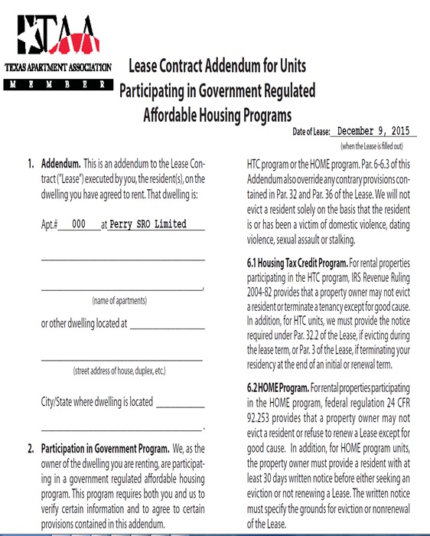
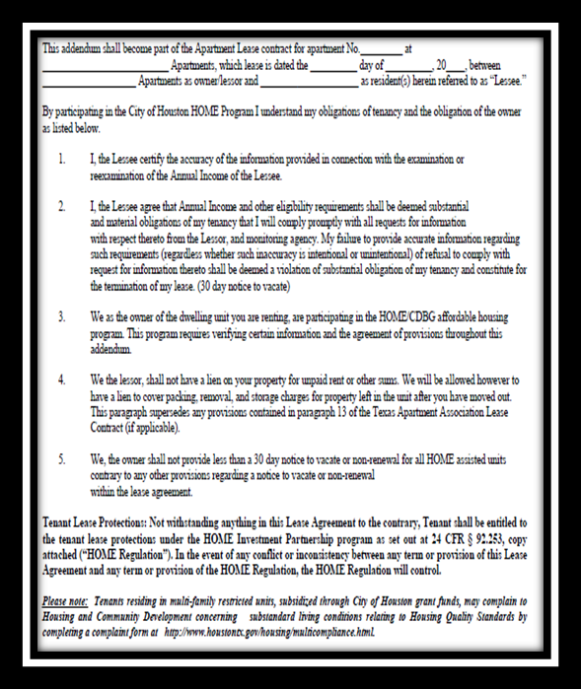
Lease Addendum Example

Slide 50
Grievance Procedures
Grievance procedures should be available to tenants that addresses tenant concerns, particularly as they relate to property management staff and how the property is managed.
They should clearly state:
To whom a tenant should direct a compliant;
Who will investigate and/or respond to the compliant; and
By when the tenant should expect to receive a response encountered and actions taken.

Slide 51
Disclosure Requirements
Lead Based Paint Addendum
The Disclosure Rule [40 CFR part 745, subpart F and 24 CFR part 35, subpart A – Requirements for Disclosure of Known Lead-Based Paint and/or Lead-Based Paint Hazards in Housing], specifies the types of information that owners must give to applicants prior to signing their leases.
These requirements apply to all properties built prior to January 1, 1978, including cooperatives, with certain exemptions established by regulation. NOTE: If a property is exempt, the owner does not need to comply with the requirements discussed.

Slide 52
ANNUAL CERTIFICATION

Slide 53
Recertifying Tenant Income Eligibility
Owners must establish a routine schedule for performing the annual income recertification. This schedule might be based on:
The anniversary of the original income verification for the tenant; or
Time of lease renewal; or
An annual schedule whereby income re-certifications for all tenant households are performed at the same time.

Slide 54
Recertification Documents
The following documents must be examined to determine if a tenant household continues to be income eligible to occupy an assisted unit:
Application
Tenant Authorization Release and Consent Form
Lease w/addendums
Tenant Income Certification
Source Documentation

Slide 56
To immediately re-designate the over-income unit as a High HOME unit
At recertification, a household in a floating Low HOME unit experiences an income increase that takes them from the Very-Low to Low Income category. The proper course of action is:
To rent the next available HOME-assisted unit as a Low HOME and then re-designate the over income unit as a High HOME unit
To terminate the tenancy of the over-income household.
To rent the next available High HOME unit as a Low HOME and then re-designate the over-income unit as a High Home unit.

Slide 57
To immediately re-designate the over-income unit as a High HOME unit
At recertification, a household in a floating Low HOME unit experiences an income increase that takes them from the Very-Low to Low Income category. The proper course of action is:
To rent the next available HOME-assisted unit as a Low HOME and then re-designate the over income unit as a High HOME unit
To terminate the tenancy of the over-income household.
To rent the next available High HOME unit as a Low HOME and then re-designate the over-income unit as a High Home unit.

Slide 58
ANNUAL COMPLIANCE REVIEW

Slide 59
Annual Compliance Review
An onsite monitoring review will be conducted to review tenant record, inspect assisted units and observe actual program operations to ensure compliance with program rules.

Slide 60
Review Assessment
The following records will be reviewed for compliance with ongoing income targeting and affordability requirements during an onsite monitoring review:
Tenant Files;
Occupancy Reports
Affirmative Marketing Material (Notes, Meeting Dates, Sites, Flyers);
Tenant Selection Plan;
Waiting List;
NTV/Eviction Letters; Refusal Rejection Letters;
30 Day Rent Increase;
Fair Housing Requirements

Slide 61
FORMS & REPORTING

Slide 62
Form(s)
To access City of Houston forms visit:
https://houstontx.gov/housing/multifamily.html#property
File Set Up: Files should be organized in an efficient and simple manner.

Slide 63
Reporting
Due Date | Reporting Period
October 15 | September 1 to September 30
January 15 | December 1 to December 31
April 15 | March 1 to March 31
July 15 | June 1 to June 30
Quarterly Occupancy Reports are due by the 15th of the month, for the prior month at the end of the quarter for the occupancy for all units
Quarterly Occupancy Reports should be forwarded to the City of Houston’s designated Compliance Monitor.
Quarterly Occupancy Reports contain Part A and Part B
Part A of the report summarizes Part B; Therefore, the figures must be consistent.

Slide 64
Rent Schedule
A proposed rent schedule along with the current utility schedule, rent and income limits are required to calculate rents.
The Compliance Monitor will review and approve rents proposed by the owner for units, subject to the maximum rent limitations.
For all units subject to the maximum rent limitations for which the tenant is paying utilities and services, the owner must ensure that the rents do not exceed the maximum rent minus the monthly allowances for utilities and services.

Slide 65
Rent Changes
The owner is never required to decrease rents below initial rents approved by the PJ.
The owner maybe able to raise a tenant’s rent depending on:
  Changes to the HUD-published HOME rent limits
  Changes in the PJ’s utility allowances
  Changes in the tenant’s income
PJs must approve all rent increases.
Rent adjustments for occupied units are subject to the terms of the tenant’s lease.

Slide 66
Rent Changes
The owner must lower the rents if the HUD-published HOME rent limits decrease, or if the tenant pays utilities and the utility allowance increases more than the HUD-published HOME rent limits.

Slide 67
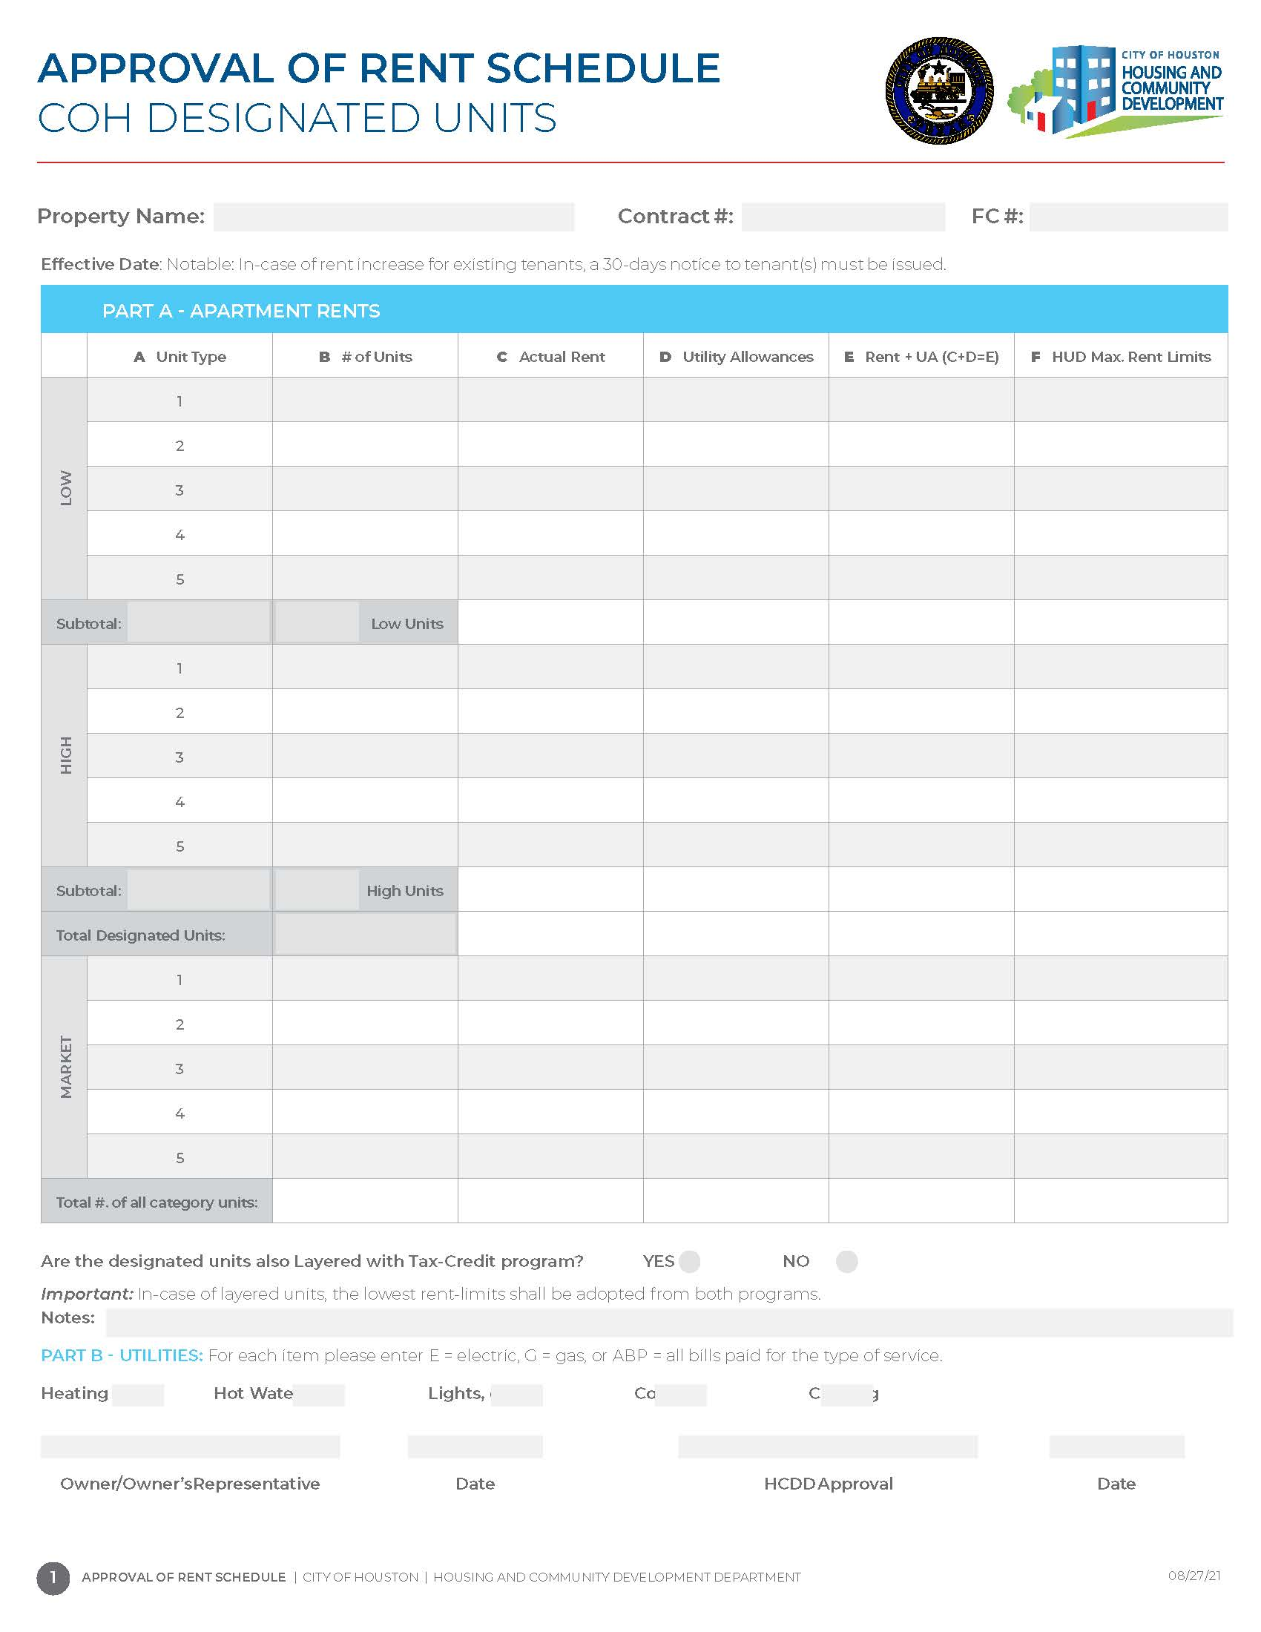
Rent
Changes

Slide 68
Utility Allowances
The owner must establish maximum monthly allowances for utilities and services (excluding telephone) and update the allowances annually.
The owner must use the HUD Utility Schedule Model (HUSM) or otherwise determine the utility allowance for the project based on the type of utilities used at the project.
Utility adjustments proposed by owners for specific projects that differ from HUSM must be approved, and supported by documentation.

Slide 69
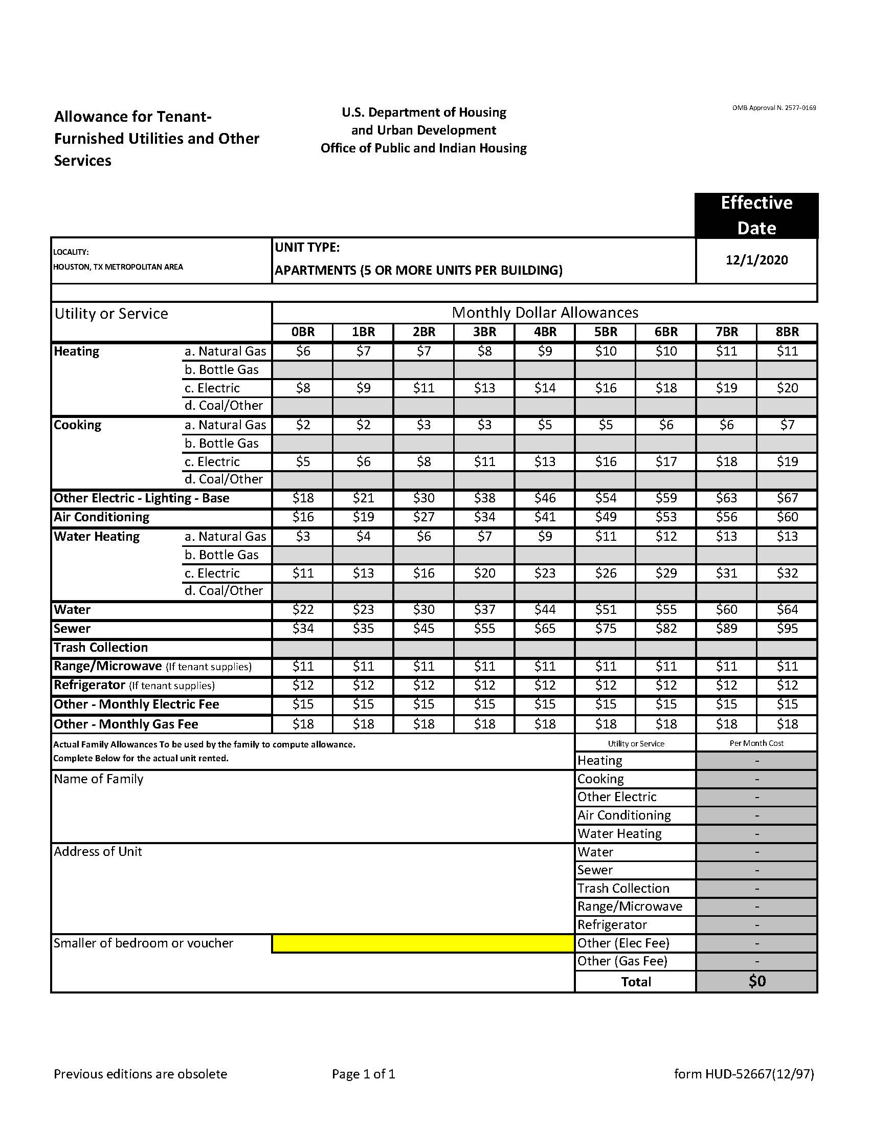
Utility Allowances

Slide 70
Regulatory Reminders
Fair Housing Poster: Owners must post and maintain the required Equal Housing Opportunity poster. Owners may use a facsimile of the poster if the facsimile and lettering are equivalent in size and legibility to the poster available from HUD. The Fair Housing Poster must be prominently displayed so it is readily apparent to all persons seeking housing.

Slide 71
Regulatory Citations
Tenant Eligibility: 24 CFR 5.609, and 5.653
Determining Income and Assets: 24 CFR 5.609
Consent Forms: 24 CFR 5.230
Restrictions on Assistance to Noncitizens: 24 CFR part 5, subpart E
Annual Income: 24 CFR 5.609
Adjusted Income: 24 CFR 5.611
Lease Requirements: 24 CFR 880.606, 881.601, 883.701, 884.215, 886.127, 886.327, 891.425, 891.625, 891.765
Annual Recertification: 24 CFR 880.603, 884.218, 886.124, 886.324, 891.410, 891.610, and 891.750
Annual Compliance Review: 24 CFR 5.659
Forms and Reporting: 24 CFR 5.609, and 5.653; 24 CFR Part 92.252
Lead-Based Paint Disclosure: 24 CFR part 35, subpart A and 40 CFR, part 745
Affirmative Fair Housing Marketing: 24 CFR 108.40
Tenant Selection Plan: 24 CFR 891.410, 891.610, 891.750

Slide 72


Questions and Comments

Slide 73



