Slide 1
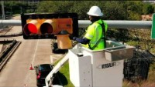

Slide 2
Community development block grant-mitigation Advisory Committee meeting
Tiffani Lawson
Capital Projects
Notes:
Good afternoon and thank you for participating in the community development block grant-mitigation advisory committee meeting today.
My name is Tiffani Lawson with Houston Public Works. The goal of today’s meeting is to inform and update you on the flood mitigation projects coming to your area and get any feedback and or question you may have about these grant funded projects. Now to Afolake Cannon with Acknowledgments

Slide 3
Acknowledgments
Council Members & Staff
Housing & Community Development Department
Planning Department
Houston Public Works
Advisory Committee
Notes:
At this time let’s introduce ourselves. If there are any Council Members on the call Any Housing & Community Development Department Planning Department Houston Public Works

Slide 4
LET’S TALK ABOUT
what is CDBG-MIT
the requirements
projects updates
Notes:
Thank you Afolake. Lets talk about the community development block grant-mitigation, the requirements and the project updates.

Slide 5
Please hold all questions
Notes:
Before we begin, I would kindly ask if you could hold all questions until the end of our presentation. Many of the answers you’re looking for will be answered within the presentation and so we’d like to respectfully ask for your full attention at this time; Later, we will open the Questions and Answers session at the end of the presentation.

Slide 6
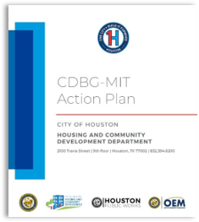
CDBG-MIT Essentials
How We Got Here
Need Assessment Development using the City’s Hazard Mitigation Plan The City Submitted the Action Plan to HUD HUD Approved the City's Action Plan
$61.8 MILLION
Allocation Amount:
Notes:
HOW WE GOT HERE…. Need Assessment Development using the City’s Hazard Mitigation Plan​ The Office of Emergency Management’s Hazard Mitigation Plan informed the ​assessment of current and future risks and how to address them with mitigation ​actions in the development of the City’s CDBG-MIT Action Plan​ ​ The City Submitted the Action Plan to HUD​ The Housing and Community Development Department (HCDD), with the help of ​Houston Public Works (HPW), identified and described mitigation activities to address the identified needs and submitted the Action Plan to HUD ​ ​ HUD Approved the City's Action Plan ​ Grant period began in May 2021 and will end in 2033​
The Allocation Amount is 61.8 Million
For more information please visit, Engagehouston.org forward slash cdbg-mitigation

Slide 7
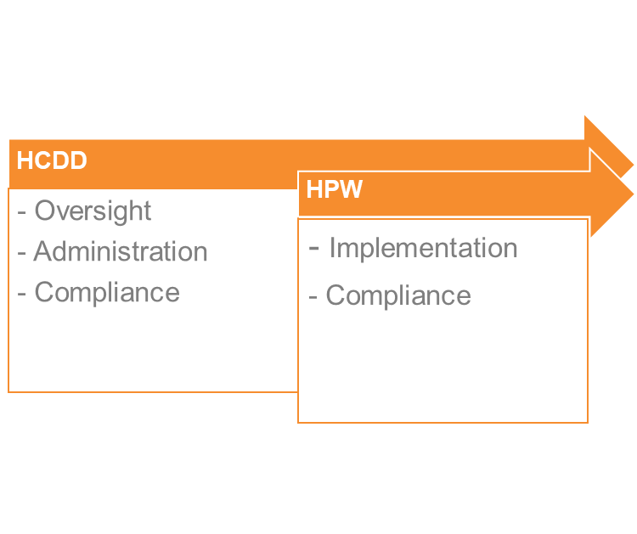
Grant Requirements:
Funds must be spent within 12 years
Half of funds must be expended during the first half (six years) of the grant
At least 50% of funding must benefit low- and moderate- income (LMI) communities
Notes:
The Grant Requirements are as follows:
Funds must be spent within 12 years
Half of funds must be expended during the first half (six years) of the grant
At least 50% of funding must benefit low- and moderate- income (LMI) communities
HCDD and HPW worked with the Mayor’s Offices of Recovery and Resilience and Sustainability to identify strategies for implementation​
HCDD managed grant set up and will provide administrative support and oversight​
HPW will work with HCDD in the compliance and implementation of infrastructure mitigation activities​

Slide 8
Citizen Advisory Committee:
Provide increased transparency in the implementation of CDBG–MIT funds
Solicit and respond to public comment and input regarding mitigation activities
Serve as an ongoing public forum to continuously inform CDBG–MIT projects and programs
Why you’re important:
Build partnerships with the community
Inform us of key community perspectives
Help us understand those perspectives
Notes:
Part of the CDBG program is to create a Citizen Advisory Committee…We need you….to serve as the conduit between this effort and the communities. Transparency is key to any capital improvement project, and we want your feedback!

Slide 9
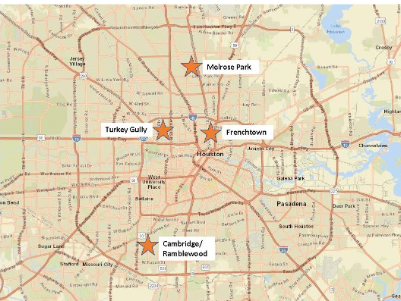
Cdbg-mit program City of Houston areas
Notes:
This map shows the 4 active CDBG-MIT projects in the Houston Area. Melrose Park, Frenchtown, Turkey Gully & Cambridge Village Park/Ramblewood
The funding is be used to carry out strategic and high-impact activities to mitigate disaster risks and reduce future losses ​
Proposed projects are partnership efforts, with a long-term impact to reduce flooding and provide resilient investments to the affected neighborhoods by leveraging local, state, and federal funds ​

Slide 10


CAMBRIDGE VILLAGE PARK
Drainage improvements in the Ramblewood neighborhood to create 24 acre-feet of detention storage.
Notes:
Cambridge Village Park has an estimated budget of 6.6 Million dollars. This project will provide drainage improvements in the Ramblewood neighborhood to create 24 acre-feet of detention storage.
Currently, the 100% design plans for the park will be finalized in Winter 2023. Afterwards, drainage improvements will be incorportaed with the finalized plans for the drainage improvements for the neighborhood. Upon completion of the final design, construction will begin. The start and completion dates for the project remain as listed on EngageHouston.org.

Slide 11
FRENCHTOWN
Improvements for conveying storm water runoff, consisting of ditch regrading and re-establishment to the receiving drainage systems, replacement and resized driveway culverts, sidewalks and asphalt pavement.
Notes:
With an estimated budget of 8.4 Million Frenchtown is currently in early design. The project will consist of asphalt pavement repairs: mill and overlay and ditch rehabilitation with no new storm drainage construction. Ditches are to be re-graded at minimum slope to provide maximum possible Level Of Service and culverts replaced as required. Construction start and completion dates are listed on the Frenchtown project page on EngageHouston.org

Slide 12
MELROSE PARK
Improvements for conveying storm water runoff including ditch regrading and re-establishment to receiving points of the Harris County Flood Control District drainage systems, replacement and resized driveway culverts, and asphalt pavement overlay or replacement.
Notes:
With an estimated budget of 19.9 Million and set to begin pending the outcome of the Harris County Flood Control project P118-23-02 Melrose Park will have improvements for conveying storm water runoff including ditch regrading and re-establishment to receiving points of the Harris County Flood Control District drainage systems, replacement and resized driveway culverts, and asphalt pavement overlay or replacement. Please refer to EngageHouston.org for all timeline updates.

Slide 13
Turkey Gully
Drainage improvement in Shady Acres Neighborhood to create drainage diversion from Turkey Gully to White Oak Bayou.
Notes:
Lastly, Turkey Gully has an estimated budget of 10 Million and is set to begin in Fall of 2024…this project will improve flooding concerns by diverting water from Turkey Gully to White Oak Bayou. Harris County Flood Control District will be participating by creating the needed detention. The design stage of the project is slated to start soon. The start and end dates for this project are listed on EngageHouston.org

Slide 14
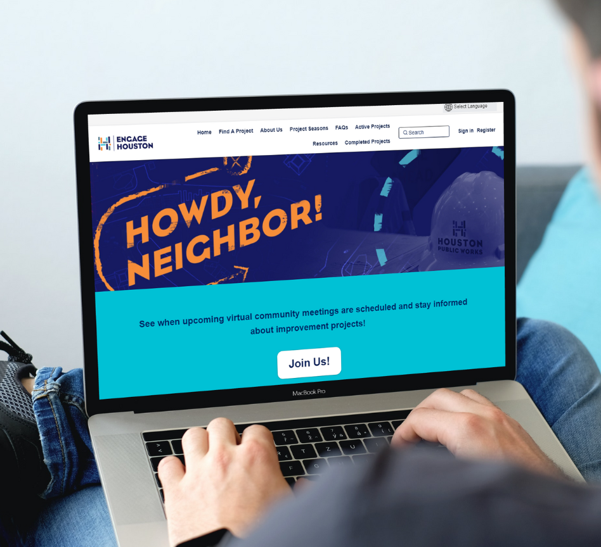
EngageHouston.org
Engage with us!
Check your project status
Ask questions
Post comments
Notes:
We encourage you to go to EngageHouston.org to view more project details, subscribe to project pages and register for EngageHouston.org.

Slide 15
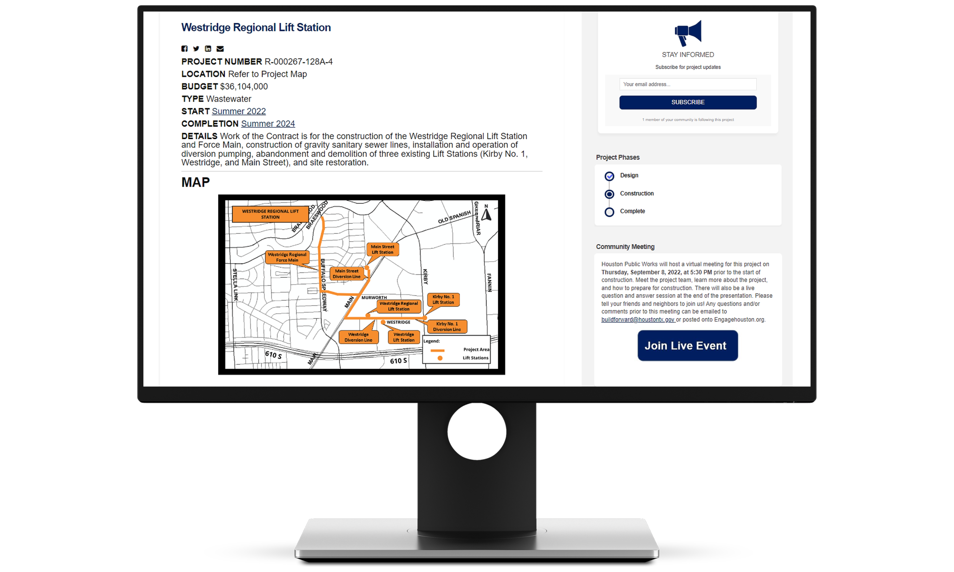
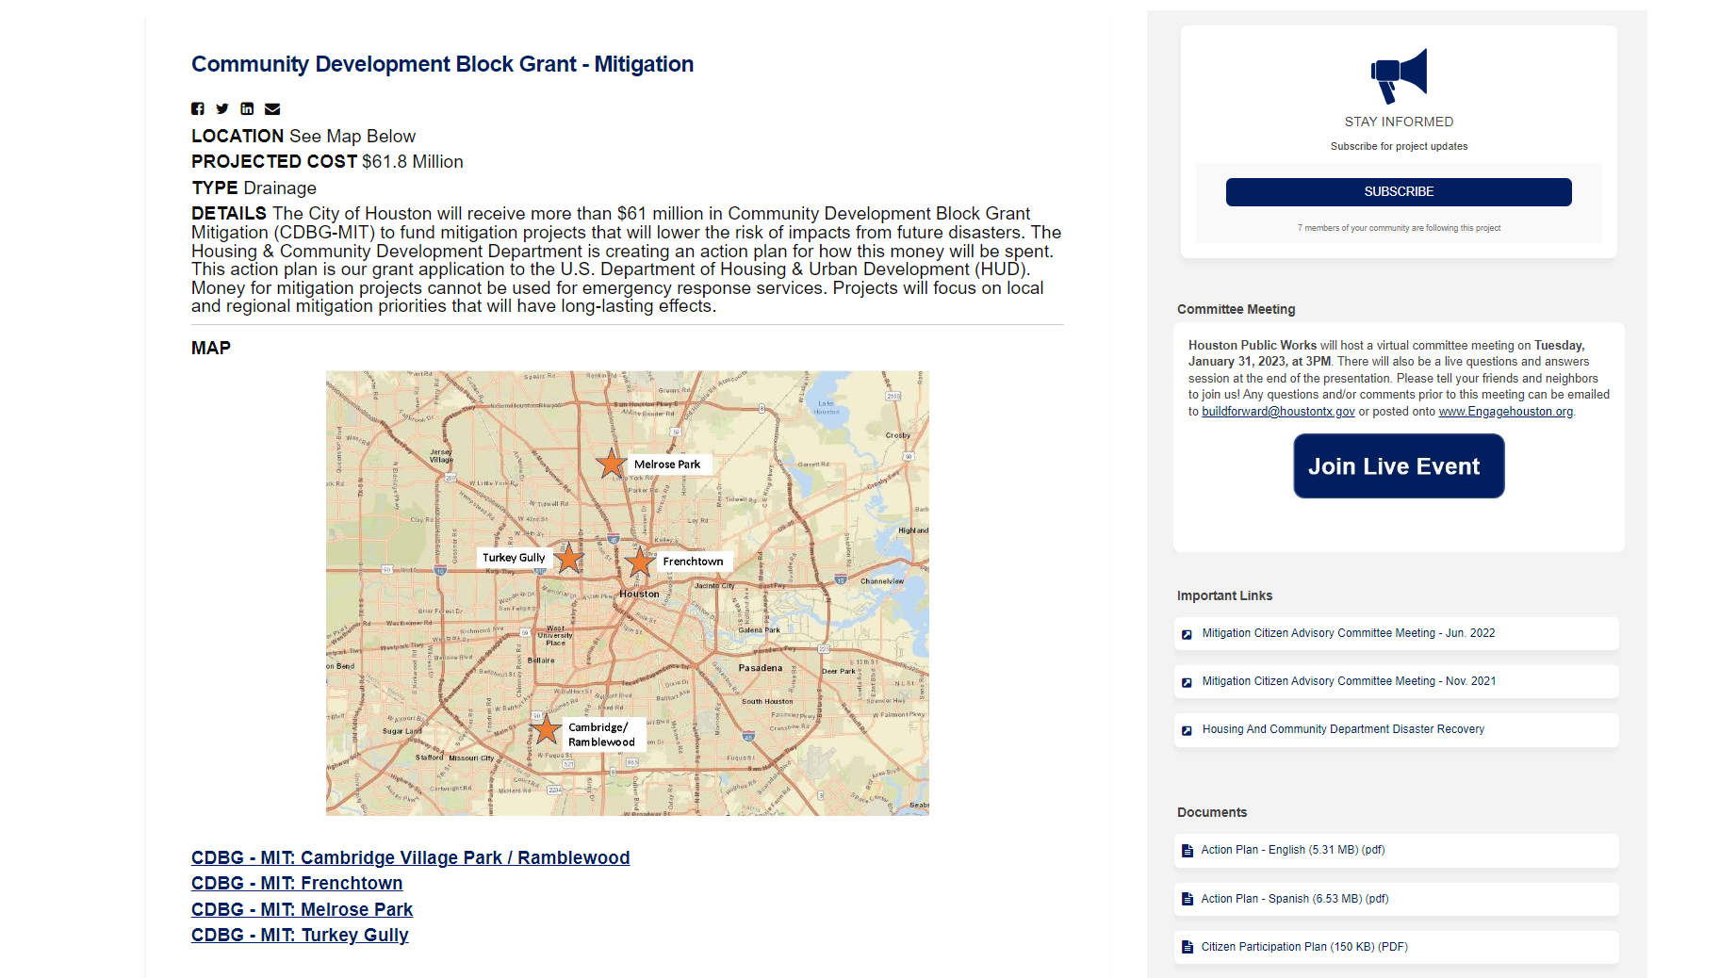
Project Page
Notes:
The project page includes additional details about these projects right at your fingertips!

Slide 16

CDBG-MIT ADVISORY COMMITTEE
Notes:
I know you are asking what I am doing and what are the expectations…right? You are serving to increase transparency in the process, offer feedback and serve as a form to foster dialogue during our progress. Your input is important because it helps us gain community perspectives and can help us understand the context for the work we're doing in the community. The commitment is attendance at the committee meetings twice a year and provide feedback on these projects.

Slide 17
thank you!
Notes:
I want to thank the project teams for their support today, Thank you to the fabulous public engagement team for making this meeting possible today. And to all of you who have joined us to receive this important project information… Thank you for your time and attention! Please remember to share what you heard today with your friends and neighbors who could not join us for this meeting.

Slide 18


QUESTIONS & ANSWERS
Select Raise Hand on the top right of the screen under Reactions or drop a line in the Chat
When your name is called, please provide your question/comment.
WWW.ENGAGEHOUSTON.ORG
Notes:
And now it’s Q&A TIME!!!!!! Being present today has its benefits… why, you ask? Because you will get your questions answered in real time by the fantastic project team. Take advantage now and ask away. The project team is here to answer your questions. Please be kind and raise your hand and we will recognize you by calling your name…at that time you can share your question and or comment with us. Thank you!

