Slide 1
Presentation to the City of Houston Budget and Fiscal Affairs Committee Impact of Fire Compensation Parity Tuesday, September 4, 2018
Tantri Emo, Chief Business Officer/Finance Director
Chief Peña, Houston Fire Chief

Slide 2
Table of Contents
Section Page
Overview 04
Assumptions & Impact 05
COH Operating Budget 06
Paying for the Referendum 07
HFD Expenditures and Revenues 08
HFD Operating Budget 09
HFD Program Improvement Needs 10
Call Volume 11
Restructuring Strategies 12
Appendix 14
Proposed Charter Amendment 15
Position Requirements 16

Slide 3
Disclaimer
Parts of this presentation are based on assumptions about the possible operation and fiscal impact of the proposed Charter Amendment that would require pay “parity” for Houston Firefighters whose pay classifications or titles, but not job duties, are the same or like those of Houston police officers with the same or a similar pay classifications or titles.
The estimated magnitude of the fiscal impact on the City’s budget and solvency may change if uncertainties about the operation of the proposed Charter Amendment are clarified.

Slide 4
Overview
In FY2014 firefighters received pay raises totaling 3% valued at $8.8 million
In FY2015 firefighters received a one time uniform allowance with a total value of $3.64 million
In June 2014 firefighters voted against a 4% across the board pay increase that would have been effective January 2015 valued at $12.4 million
In January 2018 the HPFFA walked away from a 9.5% pay increase over 3 years valued at $69 million
In May 2018, petition from Houston Professional Fire Fighters Association (HPFFA) validated by City Secretary
The City is currently under a property tax cap and facing a budget deficit of approximately close to $200 million by FY2022

Slide 5
Assumptions and Financial Impact
Assumptions on the financial impact is based on:
Base pay and special pay comparison as indicated on the petition for Charter Amendment
Based on headcount as of July 16, 2018
Includes cost for pension, FICA, overtime and higher class pay
The financial impact of the proposed Charter Amendment, the equivalent of up to a 25% average increases in both base pay and special pays in the first year
20% increase in base pay and 5% increase in special pays
First year costs are estimated at $98 million
Assuming no future pay raises for Police over three years, the cumulative cost will be up to $295.8 million
With future pay raises for Police, the annual and cumulative cost will be more
Other potential financial impact
Pension Reform
Cost of Service

Slide 6
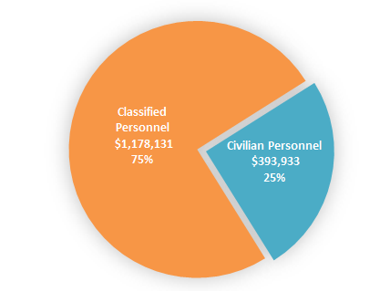
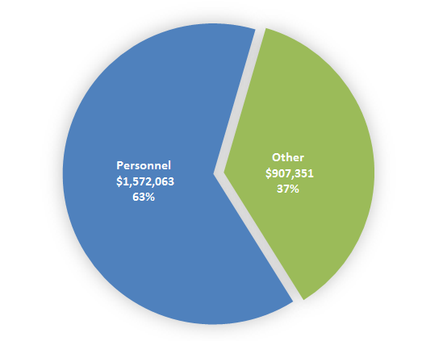
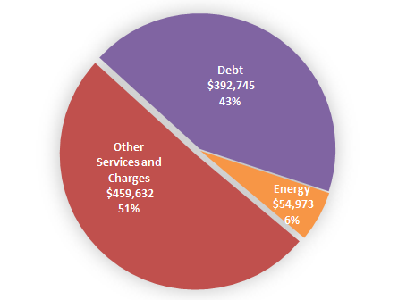
COH General Fund Budget
THE BREAKDOWN OF THE GENERAL FUND OPERATING BUDGET
The FY2019 Adopted General Fund Budget is $2.5 Billion. Sixty-three percent of the General Fund Operating is earmarked for personnel costs, with three quarters of all personnel costs related to classified employees, meaning they are first responders and other public safety workers.
FY2019 Adopted Budget = $2,479,414
$ in Thousands

Slide 7
Paying for the Fire Referendum
As of July 16, 2018 - Fire’s classified headcount is 3,958
Addressing the $98M annual budgetary deficit will mean a reduction in workforce of up to 24% or 931 firefighters.
A reduction of this size in personnel cannot be accomplished without a major restructuring of the current operations including:
Right size the current staffing model to a 3 shift work schedule
Civilianization of dispatch and inspection divisions
Revamp the EMS service delivery model
It will also require reduction in other City departments

Slide 8
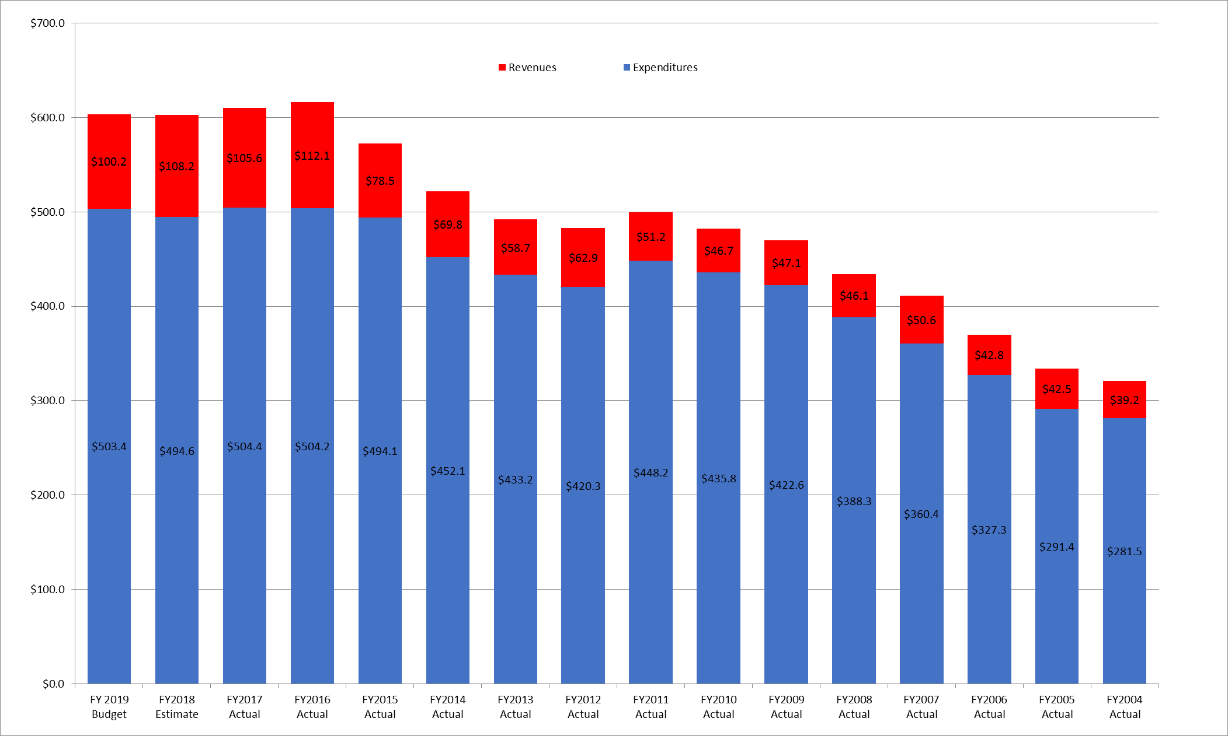
HFD Expenditures & Revenues (in Millions)
Fiscal Year Expenditures | $503.4 | $494.6 | $504.4 | $504.2 | $494.1 | $452.1 | $433.2 | $420.3 | $448.2 | $435.8 | $422.6 | $388.3 | $360.4 | $327.3 | $291.4 | $281.5
Fiscal Year Revenues | $100.2 | $108.2 | $105.6 | $112.1 | $78.5 | $69.8 | $58.7 | $62.9 | $51.2 | $46.7 | $47.1 | $46.1 | $50.6 | $42.8 | $42.5 | $39.2
Notes:
Fire Department’s historical revenues have been between 11% to 15% of its expenditures.
Increase beginning in 2014/2015 resulted from Texas Ambulance Supplemental Payment Program. Payment for systems in which allowable costs exceed the fee for service revenues.
Due to expire in 2021. The $24M to $28M annually is not guaranteed.

Slide 9
HFD General Fund Budget
THE BREAKDOWN OF THE HFD GENERAL FUND OPERATING BUDGET
HFDs FY2019 Adopted General Fund Budget is $503.4 Million. Ninety percent of HFD’s budget is earmarked for personnel costs. Ninety-eight percent of personnel costs are related to classified employees.
FY2019 Adopted Budget = $503,459,709
Civilian
$10,650,584 2%
Billing & Collections
$5,147,044 11%
Other Services
$6,961,984 14%
Medical Supplies
$3,100,940 6%
SCBA/Bunker Gear/Clothing
$4,330,529 9%
Other
$48,677,143 9.7%
Classified
$444,131,982 98%
Personnel
$454,782,566 90.3%
Restricted Accounts
$27,028,919 56%
Supplies
$2,107,727 4%

Slide 10
Program Improvement Needs
Health and Safety Programs
Professional Development
Apparatus Replacement Needs
33 Engines (approx. $20M)
17 Aerials (approx. $17M)
50 Ambulances (approx. $10M)
Annual replacement of 8% to 10% (approx. $11M/yr)
Station Improvements
Vehicle Exhaust Systems
Female Facility Upgrades
HVAC Replacements
Notes:
Health and Safety
Annual FF Physicals
Commercial Washers
Personal Protective Equipment
Professional Development
Certifications Training
Supervisory/Leadership Training
IMT Training
Active Shooter Training
Terrorist Response Training
Station Improvements
Vehicle Exhaust Systems
Female Facility Upgrades
HVAC Replacements
Kitchen Upgrades
Apparatus Replacement Needs
33 Engines (approx. $20M)
17 Aerials (approx. $17M)
50 Ambulances (approx. $10M)
Annual replacement of 8% to 10% (approx. $11M/yr)

Slide 11
Call Volume
Date Range | Fire Related Inc. | EMS Related Inc. | Total Inc.
Jan 1 - Dec 31, 2016 | 42,109 | 293,858 | 335,967
Jan 1 - Dec 31, 2015 | 43,056 | 289,907 | 332,963
Jan 1 - Dec 31, 2014 | 41,747 | 276,880 | 318,627
Jan 1 - Dec 31, 2013 | 42,064 | 257,107 | 299,171
EMS Resource Management 2017 = 12.4% Fire Resource Management 2017 = 1%

Slide 12
Restructuring Strategies
3 shift work schedule
46.7 hours + 9.3 overtime hours
Attrition of 720 Classified Employees
No financial savings
46.7 hours with Kelly Days
Attrition of 300 Classified Employees
Increase of ~$25.4M
Notes:
Right size the current staffing schedule to a 3 shift work schedule
Option A – 46.7 hours + 9.3 overtime hours (Staffing headcount 3,238 from Baseline of 3,958)
Option B – 46.7 hours with Kelly Days (staffing headcount of 3,658 from Baseline of 3,958)

Slide 13
Restructuring Strategies
Civilianization
LSB
Attrition of 119 Classified Employees
~$4.9M annual savings
Dispatch Division
Attrition of 78 Classified Employees
~$3.1M annual savings
EMS Division
Attrition of 824 Classified Employees
~$10.9M annual savings
Notes:
Total Term pay exposure = ~$63M (Assumption = $36K)
Civilianization of Inspection and Dispatch (Hybrid model consisting of classified and civilian employees)
Inspection headcount = 119 Civilian
Dispatch headcount = 80 Civilians
Civilianization of EMS Division = 920 Civilian
Mobile Integrated Healthcare Initiatives
Billing and Revenue Enhancement
All Hazards Savings

Slide 14
Appendix

Slide 15
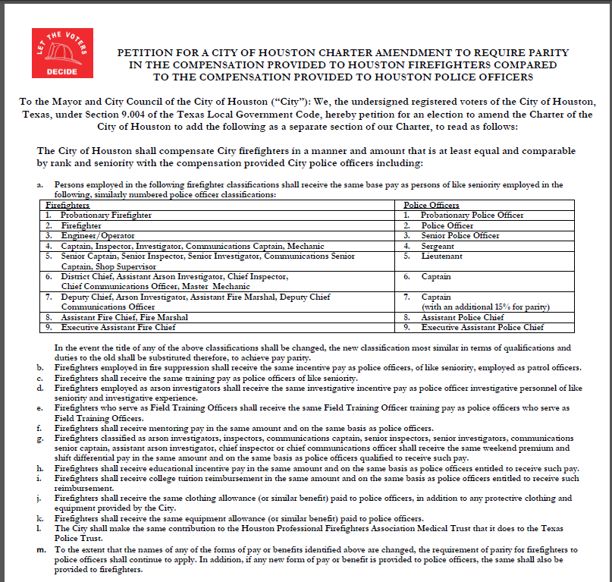
Proposed Charter Amendment - HFD

Slide 16
Position requirements
 | HFD | HFD REQUIREMENT | HPD | HPD REQUIREMENT
1 | Probationary Firefighter | - Minimum age to apply is 18 and must not reach his/her 36th birthday before receiving the oath of office - Education & Certifications – Certified cadets 15 college hours with a grade of ‘C’ or higher, and active Fire and EMT certifications - Education – Non Certified cadets 24 college hours with a grade of ‘C’ or higher, or 2 years of full time active duty military service with an honorable discharge | Probationary Police Officer | - At least 48 semester hours of credit from an accredited college or university with at least a 2.0 grade point average; OR - A minimum of 18 months active duty in the United States armed forces and received an honorable discharge; OR - At least five years of full-time employment as a peace officer licensed by TCOLE or an equivalent licensing entity in another state.
2 | Firefighter | -Automatic title after successfully completing the probationary period | Police Officer | -Automatic title after successfully completing the probationary period
3 | Engineer/Operator | - Exam - 2 years in the previous rank | Senior Police Officer | - No Exam - At least 12 years of service(experience) w/training or - At least 17 years of service (experience)
4 | Captain, Inspector, Investigator, Communications Captain, Mechanic | - Exam - 2 years in the previous rank | Sergeant | -Exam -4.5 years of service

Slide 17
Position requirements
 | HFD | HFD REQUIREMENT | HPD | HPD REQUIREMENT
5 | Senior Captain, Senior Inspector, Senior investigator, Communications Senior Captain, Shop Supervisor | - Exam - 2 years in the previous rank | Lieutenant | - Exam - 2 years in previous rank - Associate’s Degree or higher or 65 hours of coursework
6 | District Chief, Assistant Arson Investigator, Chief Inspector, Chief Communications Officer, Master Mechanic | - Exam - 2 years in the previous rank - 4 years in the department | Captain | - Exam - 2 years in previous rank - Bachelor’s degree
7 | Deputy Chief, Arson Investigator, Assistant Fire Marshal, Deputy Chief Communications Officer | -Exam -2 years in the previous rank | Captain (with additional 15% for parity) | No Equivalent
8 | Assistant Fire Chief, Fire Marshal | -Appointed Position - AFC – 5 years as certified firefighter | Assistant Police Chief | -Appointed Position -Master’s degree -At least 5 years from sworn date with HPD
9 | Executive Assistant Fire Chief | -Appointed Position | Executive Assistant Police Chief | -Appointed Position -Master’s degree -At least 5 years from sworn date with HPD

